Slide 1
Retain Your Brain
How to age-proof your most valuable asset
© 2023 by Hartford Funds
Notes:
Can your brain get younger?
In some illuminating studies, researchers performed magnetic resonance imaging (MRI) scans on participants’ brains. Some of the participants implemented key lifestyle changes (the same ones we’ll discuss later). Follow-up brain scans taken six months to a year later revealed that their brains looked younger than before. It was as if the participants in the experimental group had put their brains in a time machine.¹
It’s understandable that we’re desperate for a quick fix to one of the greatest collective health fears we have: Losing your memory and having your mind go from a high-functioning piece of biological wizardry to a lump of gray matter that struggles to remember what day it is.
When I say “wizardry,” I’m not exaggerating. A healthy brain is an amazing thing. It can effectively learn, remember, manage emotions, analyze, make good decisions, create, and innovate. A healthy brain can also let you do the electric slide, laugh (at people doing the electric slide), navigate, and hit a perfect golf shot (well, sometimes). A well-functioning functioning brain is essential for being the best version of you.
So can we prevent, or at least slow, the aging of our brains?
Today, we’ll discuss action steps you can take to protect your brain and optimize your brain health today and tomorrow so you can remain being the best version of yourself.
¹Jason Steffener et al., “Differences between chronological and brain age are related to education and self-reported physical activity,” Neurobiology of Aging 40 (2016): 138, https://doi.org/10.1016/j.neurobiolaging.2016.01.014; June C. Lo et al., “Sleep Duration and Age-Related Changes in Brain Structure and Cognitive Performance,” SLEEP (2014), https://doi.org/10.5665/sleep.3832

Slide 2
Investing involves risk including possible loss of principal. Information is current as of the date of this material.
Any opinions expressed herein are from a third party and are given in good faith, are subject to change without notice, and are considered correct as of the stated date of their issue.
Merrill Lynch, Pierce, Fenner & Smith Incorporated is not a tax or legal advisor. Clients should consult a personal tax or legal advisor prior to making any tax or legal related investment decisions.
Bank of America Corporation (“Bank of America”) is a financial holding company that, through its subsidiaries and affiliated companies, provides banking and investment products and other financial services .
Merrill Lynch, Pierce, Fenner & Smith Incorporated (also referred to as “MLPF&S” or “Merrill”) makes available certain investment products sponsored, managed, distributed or provided by companies that are affiliates of Bank of America Corporation (“BofA Corp.”). MLPF&S is a registered broker-dealer, registered investment adviser, Member SIPC and a wholly owned subsidiary of BofA Corp. Merrill Lynch Life Agency Inc. (“MLLA”) is a licensed insurance agency and a wholly owned subsidiary of BofA Corp.
This material does not take into account a client’s particular investment objectives, financial situations, or needs and is not intended as a recommendation, offer or solicitation for the purchase or sale of any security or investment strategy. Merrill offers a broad range of brokerage, investment advisory (including financial planning) and other services. There are important differences between brokerage and investment advisory services, including the type of advice and assistance provided, the fees charged, and the rights and obligations of the parties. It is important to understand the differences, particularly when determining which service or services to select. For more information about these services and their differences, speak with your Merrill financial advisor.
Nothing discussed or suggested in these materials should be construed as permission to supersede or circumvent any Bank of America, Merrill Lynch, Pierce, Fenner & Smith Incorporated policies, procedures, rules, and guidelines.
Investment products offered through MLPF&S and insurance and annuity products offered through Merrill Lynch Life Agency Inc.:
Are Not FDIC Insured | May Lose Value | Are Not Bank Guaranteed
Are Not Insured by Any Federal Government Agency | Are Not Deposits | Are Not a Condition to Any Banking Service or Activity

Slide 3
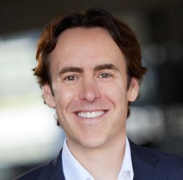
“We have strong evidence that simple lifestyle interventions can dramatically improve brain health and lower the risk of disease today, tomorrow, and in years to come.”
Marc Milstein, PhD
Notes:
Dr. Marc Milstein is a leading scientific researcher on neuroscience, health, and happiness. His insights provide science-based solutions to keep the brain healthy, lower the risk of dementia, boost productivity and maximize longevity. He earned both his Ph.D. in Biological Chemistry and his Bachelor of Science in Molecular, Cellular, and Developmental Biology from UCLA.
The views and opinions expressed herein are those of the author, who is not affiliated with Hartford Funds. If you are concerned about your brain health or cognitive function, it's a good idea to speak with your doctor or a healthcare professional, who can evaluate your cognitive function and provide recommendations for management and treatment, if necessary.

Slide 4
Agenda
Your Age vs. your Brain’s Age
The Importance of Brain Health
How to Age-Proof Your Brain
Notes:
Here are three areas we’ll consider [read slide]
4

Slide 5
Your Age vs. your Brain’s Age
© 2023 by Hartford Funds
Notes:
Let’s begin with our analysis in the first area…

Slide 6
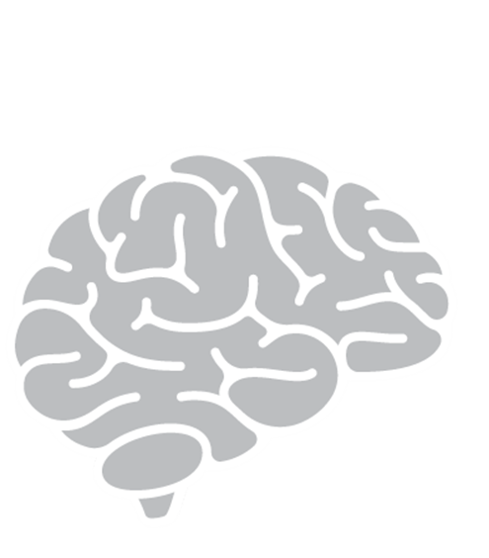
Your Brain May Not Be the Same Age as You
Notes:
Just because you’re getting older doesn’t mean your brain has to age at the same rate.
It may sound strange, but our brains are often not the same age as our chronological age. For example, a person could be 60-years-old and have a brain age of 50 or perhaps 70. We’ll talk about how this can be. But for now, it’s an important concept to understand and to realize that you have significant control over the age of your brain.
More and more research points us to a compelling conclusion and powerful message: that we—not our genes—can have control over our cognitive health today and the destiny of our brains.

Slide 7
Super-Agers Have Younger Brains
Notes:
You may have heard of Blue Zones. They’re areas around the world where people live the longest and healthiest lives: Ikaria, Greece; Ogliastra Region, Sardinia; Loma Linda, California; Nicoya Peninsula, Costa Rica.
Similarly, researchers have identified a group of people called SuperAgers, who are in their eighties and beyond but have the cognitive function of those decades younger.
Since 2008, Northwestern scientists have studied SuperAging. Using magnetic resonance imaging (MRI), scientists measured the thickness of the cortex in 24 SuperAgers and 12 members of a control group.¹
Another study followed 340 SuperAgers.²
Because SuperAgers lose brain volume more slowly than their peers, they may be better protected from dementia.
[Optional: Common Habits of SuperAgers
Live an active lifestyle (exercise) - People in their 80s who exercised at high intensity for 20 to 45 minutes a day have an aerobic capacity of people approximately 30 years younger.
Embrace mental challenges - The moment you feel like something is “too hard” is the moment you have the best opportunity to fortify your brain and create new pathways
Social butterflies –They’re typically surrounded by family and friends, and can often be found volunteering in the community
Manage stress – Superagers have great resilience in the face of stress. Some stress is good for you. But too much stress can cause chronic inflammation and lead to anxiety, depression and dementia.]
[Insert personal story about an aging friend or relative who seems like a SuperAger]
We’ll touch on some of the habits that these SuperAgers share later, but next, let’s see how you can find out the age of your brain.
[Optional detail on Blue Zones: In these areas, people tend to live well into their 90s and 100s, and they suffer from lower rates of chronic diseases such as heart disease, cancer, and diabetes. Researchers have attributed the longevity and health of these populations to a variety of factors, including a mostly plant-based diet, regular physical activity, strong social connections, and a sense of purpose or meaning in life.]
¹4 Habits of “SuperAgers”, Northwestern Medicine, 8/28/18
²Nina Beker et al., “Association of Cognitive Function Trajectories in Centenarians With Postmortem Neuropathology, Physical Health, and Other Risk Factors for Cognitive Decline,” JAMA Network Open 4, no. 1 (2021): e2031654, https://doi.org/10.1001/jamanetworkopen.2020.31654

Slide 8
How well can I manage my day?
How well can I remember important information?
How well can I move and maintain balance?
How fast can I walk?
How old do I feel?
Get a Sense of Your Brain Age
Notes:
While we are not at the point where every person can slide into a brain scanner and find out their brain age, here are a few factors that can help give you a sense of your brain age. Ask yourself the following questions:
How well can I manage my day?
It is understandable to misplace your keys or forget an appointment from time to time, but any signs of increasing forgetfulness are something we want to address. We don't want to ignore any signs of mental decline. A condition called Mild Cognitive Impairment (MCI) impacts approximately 12 to 18% of those over 65 years of age. MCI is not dementia, but it is increasing signs of memory issues and decreasing cognitive function. It can be a precursor and raise the risk of developing dementia.
Marisa K. Heckner et al., “The Aging Brain and Executive Functions Revisited: Implications from Meta-analytic and Functional-Connectivity Evidence,” Journal of Cognitive Neuroscience 33, no. 9 (2021): 1716–1752, https://doi.org/10.1162/jocn_a_01616
How well can I move and maintain balance?
Your brain controls your balance and balance is a use-it-or-lose-it skill. Loss of balance increases the risk of falls, which can cause head injuries. Head injuries increase the risk of dementia. As we get older, we can participate in fewer activities that keep our balance strong.
Rachael D. Seidler et al., “Motor control and aging: links to age-related brain structural, functional, and biochemical effects,“ Neuroscience & Biobehavioral Reviews 34, no. 5 (2010): 721–733, https://doi.org/10.1016/j.neubiorev.2009.10.005.
How well can I remember important information?
We want to dispel the myth that losing memory is a normal aging process. Significant memory loss is not normal. We currently live in a world where most of the things we want to recall are stored at our fingertips in our phones. Since recall can also be a use it or lose it skill, we want to make sure we are still practicing learning and remembering information. When we practice our recall, we strengthen our memories.
Philip C. Ko et al., “Understanding age-related reductions in visual working memory capacity: Examining the stages of change detection,” Attention, Perception, & Psychophysics 76 (2014): 2015–2030, https://doi.org/10.3758/s13414-013-0585-z.
How fast can I walk?
Studies have shown that walking speed is tied to memory function. It's important to take an assessment of your walking speed. You don't need to power walk everywhere you go but consider short bursts of increased walking pace, even for a couple of minutes a day. A study found 9 minutes of day of more intense walking can improve memory.
Line Jee Hartmann Rasmussen et al., “Association of Neurocognitive and Physical Function With Gait Speed in Midlife,” JAMA Network Open 2, no. 10 (2019): e1913123, https://doi.org/10.1001/jamanetworkopen.2019.13123; Stephanie Studenski, “Gait Speed Reveals Clues to Lifelong Health,” JAMA Network Open 2, no. 10 (2019) e1913112, https://doi.org/10.1001/jamanetworkopen.2019.13112.
How old do I feel?
There is a powerful connection between your perspective and healthy aging. Studies have found that those with a positive attitude toward the aging process have a 50% reduced chance of developing dementia. Those with a healthy attitude towards the aging process often participate in activities that make the brain more youthful and thus protected.
Seyul Kwak et al., “Feeling How Old I Am: Subjective Age Is Associated With Estimated Brain Age,” Frontiers in Aging Neuroscience 10 (2018), https://doi.org/10.3389/fnagi.2018.00168.

Slide 9
“Oh, that’s part of normal aging. There’s nothing I can do.”
“I have relatives with dementia; it’s in my genes”
© 2023 by Hartford Funds
Notes:
Some people might think, “My grandmother had dementia, my mom had it, so I’m gonna get it.”
The good news is, serious mental decline is not an inevitable part of aging. For example, it’s estimated that a third of all current cases of dementia could have been prevented by changes in lifestyle.¹
2019 Alzheimer’s Association research found that certain lifestyle factors have a greater impact than your genes do on whether you’ll develop memory-related diseases. In 2020, researchers at Rush Medical Center in Chicago found that those who followed recommendations for simple lifestyle modifications reduced their risk of developing Alzheimer’s by nearly 60 percent.²
Only 1-to-5 percent of all cases of Alzheimer’s are strictly genetic. That means most of us are not destined to develop Alzheimer’s based on our genes. Those 1-to-5 percent of strictly genetic cases are due to deterministic genes: rare genes that, if inherited, mean that someone will definitely develop early-onset Alzheimer’s (that’s when the disease sets in between one’s early forties and mid-fifties).³
In another study, people with highest genetic risk who maintained the brain-healthy lifestyles lowered their risk of dementia by half, compared to people of similar genetic risk who did not maintain them.⁴
While there are no guarantees to prevent mental decline, it’s important to know that we can have an impact on our brain health.
¹ Gill Livingston et al., “Dementia Prevention, Intervention, and Care,” Lancet 390, no. 10113 (2017): 2673–2734, https://doi.org/10.1016/S0140-6736 (17) 31363–6 ² Klodian Dhana et al., “Healthy Lifestyle and the Risk of Alzheimer Dementia,” Neurology 95, no. 4 (2020): e374–e383, https://doi.org/10.1212/WNL.0000000000009816.
³ Joseph F. Arboleda-Velasquez et al., “Resistance to autosomal dominant Alzheimer’s disease in an APOE3 Christchurch homozygote: a case report,” Nature Medicine 25 (2019): 1680–1683, https://doi.org/10.1038/s41591-019-0611-3.
⁴ Ilianna Lourida et al., “Association of Lifestyle and Genetic Risk With Incidence of Dementia,” JAMA 322, no. 5 (2019): 430–437, https://doi.org/10.1001/jama.2019.9879.

Slide 10
The Importance of Brain Health
© 2023 by Hartford Funds
Notes:
Now, lets move on to our next section: The Importance of Brain Health

Slide 11
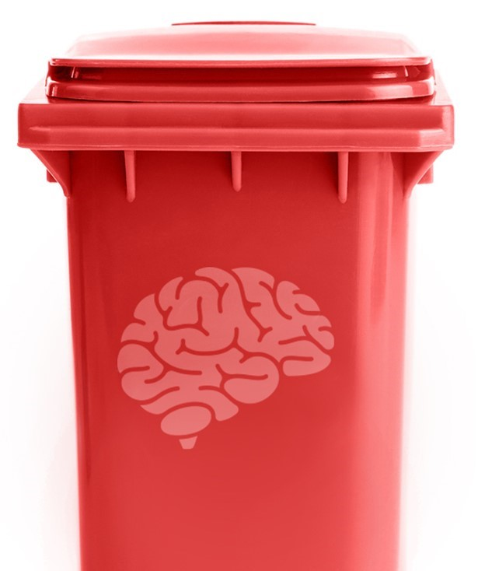
Brain Trash
A byproduct of the work your cells do
A 3lb. brain makes 5lb. of trash per year
The more built-up trash, the “older” the brain
© 2023 by Hartford Funds
Notes:
One of the things that makes a brain older, or age prematurely, is the buildup of trash and toxins. The trash is a by-product of the work your brain cells do. Each of your brain cells is like a hustling, bustling Manhattan. Just like how a city can get dirty, in the process of living, your brain gets dirty as well—filled with waste in the form of leftover chemical reactions, environmental toxins, old, damaged cells, and no-longer-needed proteins. Your three-pound brain makes five pounds of trash a year. This trash is normally recycled or flushed out, but if those processes break down, the trash can build up and damage the brain.

Slide 12
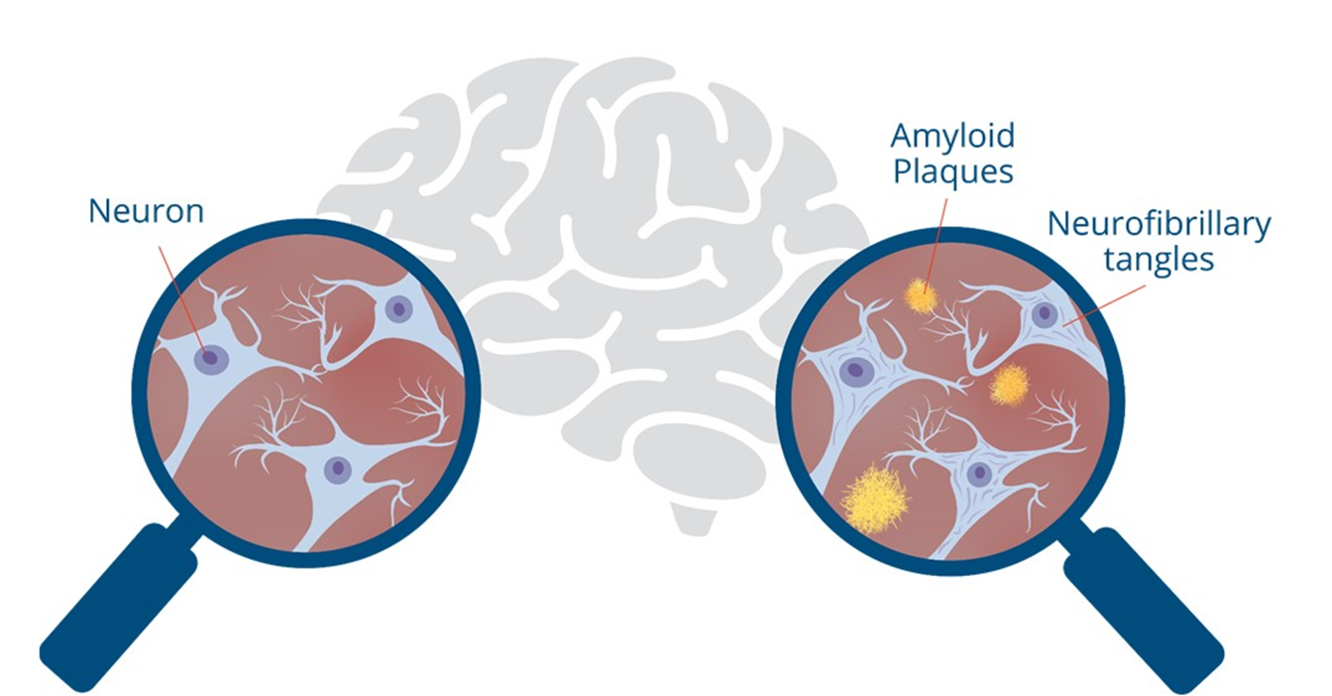
Normal
Alzheimer’s
When Brain Trash Builds:
Plaques and Tangles
Notes:
Plaques and tangles are the two most common forms of brain trash found in Alzheimer’s disease.
Plaques are deposits of a protein fragment called beta-amyloid (BAY-tuh AM-uh-loyd) that build up in the spaces between nerve cells.
Tangles are twisted fibers of another protein called tau (rhymes with “wow”) that build up inside cells.
Plaques and tangles stop communication between nerve cells and cause them to die. Vascular dementia is cognitive impairment caused by damage to the blood vessels in the brain.
Buildup of waste in general can also lead to symptoms such as diminished focus, loss of productivity, and a drastic reduction in overall energy—signs and symptoms of biological aging. Simply put, the more trash, the “older” the brain.
So, can we get rid of trash? While there’s no brain shampoo, scientists have made a series of discoveries that show your body has powerful cleaning methods to literally take out the trash. We’ll talk about how your body can get rid of brain trash in just a bit.

Slide 13
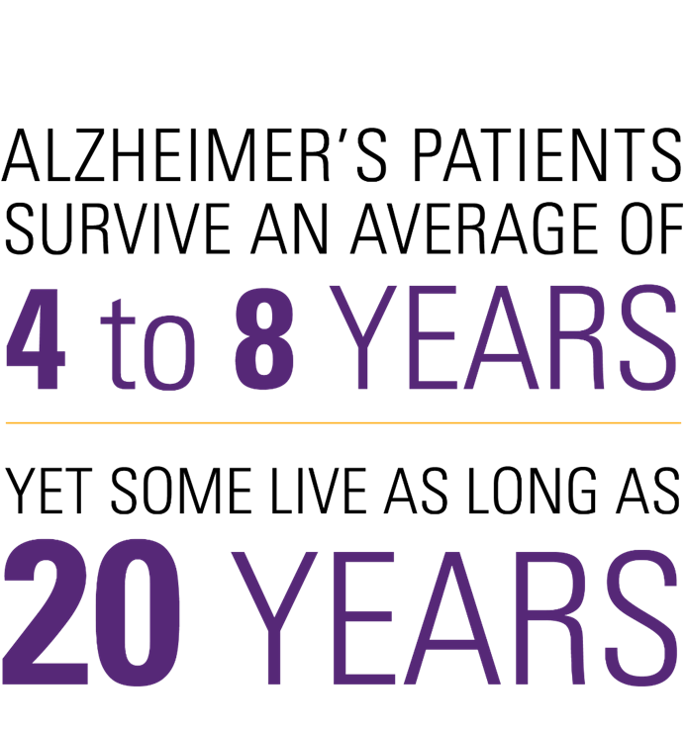
The Cost of Dementia and Alzheimer’s
Medication
Caregiving
Housing needs
Source: Alzheimer's Disease and Dementia Life Expectancy, VeryWellHealth, 1/6/23
Notes:
The costs associated with dementia can be significant. In addition to medical costs, other areas of expenses may include caregiving, medication, and housing needs.
Let’s touch on some of the trends that are increasing the costs of dementia and Alzheimer’s.
According to the Alzheimer’s Association, people 65 and older survive an average of four to eight years after a diagnosis, yet some live as long as 20 years with the disease.¹
Alzheimer’s Diagnoses are on the rise.
2023 estimate for Americans living with Alzheimer’s: 6.7 million²
2030 estimate: 8.5 million¹
2050 estimate: 12.7 million¹
To plan for your financial needs during the course of Alzheimer's disease, you'll need to consider all the costs you might face now and in the future. Since Alzheimer's is a progressive disease, the type and level of care needed will intensify over time.
The more financial planning that can be done soon after an Alzheimer’s diagnosis, the better prepared one will be for financial issues and expenses — especially while people can still make financial and caregiving decisions for themselves.
Concerning the cost of Alzheimer’s medications, one new drug, Aduhelm, is priced at approximately $28,000/year.³ Medicare typically covers 80% of the cost of medication. For just that one drug, patients would pay 20% of the cost—$5,600. Medicare has limited coverage for this medication to beneficiaries enrolled in clinical trials.
Next, we’ll look at potential caregiving and housing costs.
¹Alzheimer's Disease and Dementia Life Expectancy, VeryWellHealth, 1/6/23
²Fox Business, 3/16/23
³Medicare Limits Coverage of Controversial New Alzheimer’s Drug, AARP, 4/8/22

Slide 14
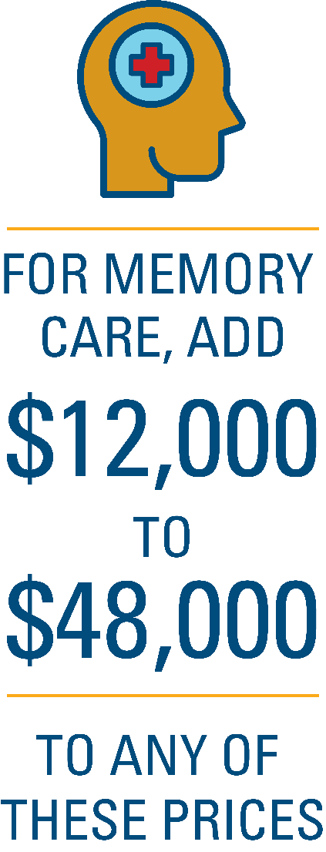
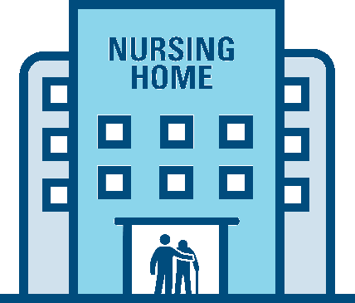
The Progression of Care Costs
Annual National Average Cost
Source: Cost of Care Survey, Genworth, 2022
Source: What Is Memory Care? Costs, Benefits And More, Forbes, 2/20/23
Notes:
Initially, a person with a dementia diagnosis can live independently. Often, care is provided by family and friends.
But as the disease progresses, full-time care from a home-health aid (a person hired to help with basic daily activities and physical care, or require assistance with shopping, cooking, or paying bills) may be needed.
[Review costs of home health aid]
During the middle stages of Alzheimer's, it becomes necessary to provide 24-hour supervision to keep the person with dementia safe. As the disease progresses into the late-stages, around-the-clock care requirements become more intensive.
Making the decision to move into long-term care, e.g., assisted-living or nursing-home care, may be very difficult, but it’s not always possible to continue providing the level of care needed at home.
Stats:
Among the 1.2 to 1.4 million long-stay residents in the US, at least two-thirds are estimated to have Alzheimer’s disease and related dementias¹
Among new nursing home admissions, which are commonly precipitated by hospitalization, more than 40% of the patients are estimated to have Alzheimer disease and related dementias or cognitive impairment¹
¹ Risk of Discharge to Lower-Quality Nursing Homes Among Hospitalized Older Adults With Alzheimer Disease and Related Dementias, Journal of the American Medical Association, 2/8/23
[Review costs of assisted living, nursing home, and memory care costs]

Slide 15
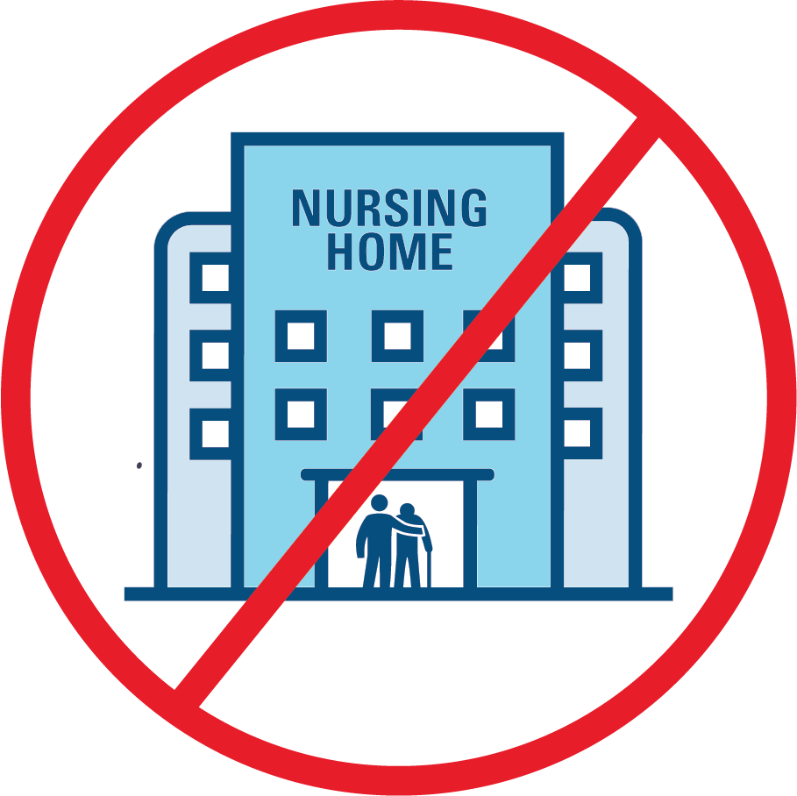
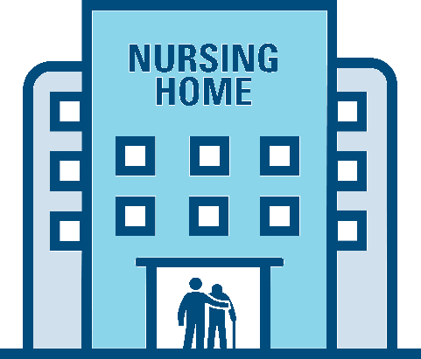
Medicare doesn’t pay for long-term nursing home stays
Medicaid may pay for long-term nursing home stays (income and asset limits)
Notes:
Medicare covers up to 100 days of "skilled nursing care" per illness, but there are a number of requirements that must be met before the nursing home stay will be covered. The result of these requirements is that Medicare recipients are often discharged from a nursing home before they are ready.¹
Medicare does not cover the costs of long-term stays in nursing homes.¹
Medicaid may pay for nursing-home care. In all 50 states and the District of Columbia, Medicaid will pay for nursing-home care for persons who require that level of care and meet the program’s financial eligibility requirements. Be aware that the financial requirements and the level-of-care requirements vary based on the state.
Furthering the complexity is that the financial requirements change based on the marital status of the Medicaid beneficiary/applicant. For those who are eligible and meet the income and asset limits, Medicaid will pay for the complete cost of nursing-home care, including room and board. Medicaid generally requires a person exhaust most of their assets before it kicks in. Medicaid is a form of welfare—or at least that’s how it began. So to be eligible, you must become “impoverished” under the program’s guidelines.
Medicaid will cover this cost on an ongoing, long-term basis for however long that level of care is required, even if it is required for the remainder of one’s life.²
¹Medicare's Limited Nursing Home Coverage, ElderLawAnswers, 1/7/22
²Medicaid Coverage of Nursing Home Care | When, Where and How Much They Pay, American Council on Aging, 12/26/22

Slide 16
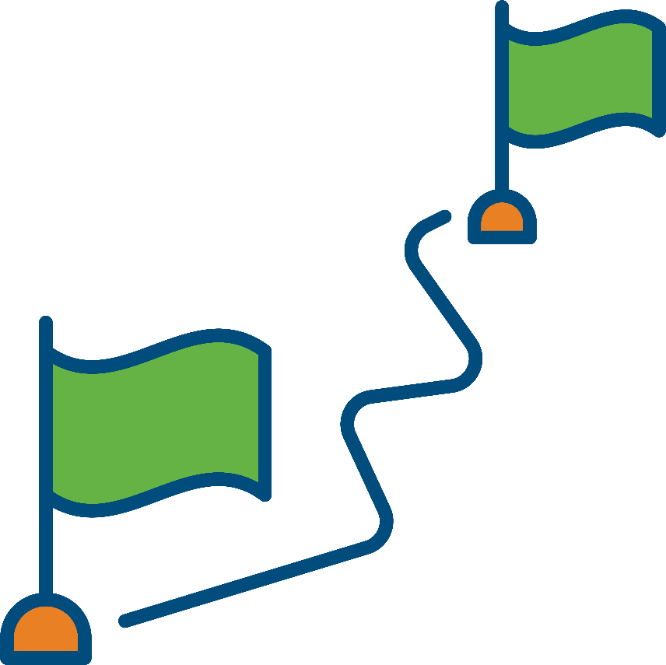
$392,874
Estimated Lifetime Cost of Dementia Care
Medical expenses
Caregiving
Home modifications
Lost income
Legal fees
Hospice and end-of-life care
Source: 2023 Alzheimer’s Disease Facts and Figures Report: At a Glance Statistics, Alzheimer’s Association, 2023
Notes:
The total lifetime cost of care for someone with dementia is estimated at $392,874 in 2021 dollars.¹
These costs may include:
Medical expenses: This includes doctor's visits, hospitalizations, and medication costs.
Caregiving costs: Dementia patients often require round-the-clock care, which can be provided either by family members or professional caregivers. This can be a significant expense, particularly if the patient requires skilled nursing care.
Home modifications: As the disease progresses, patients may require modifications to their home to make it safer and more accessible. These modifications can include installing handrails, wheelchair ramps, and stairlifts.
Lost income: Caregivers may need to reduce their work hours or stop working altogether to care for their loved ones with dementia. This can result in a significant loss of income.
Legal and financial fees: As the disease progresses, patients may become unable to manage their own affairs. This can lead to legal and financial issues that require the assistance of an attorney or financial professional.
Hospice and end-of-life care: In the later stages of dementia, patients may require hospice or end-of-life care. These services can be expensive and may not be covered by insurance.
From a financial standpoint, obviously, we’d all love to say there are things we can do to eliminate the risk of dementia, Alzheimer’s, and mental decline. While that may not be practical, I think we can all agree that if we could postpone the age at which it occurs, it would impact this number and, beyond the number, our quality of life. If there’s anything we can do to maintain a healthy brain as long as we can, we should be interested in doing that.
There are steps you can take to prepare for the potential costs of cognitive decline for you or a loved one:
Start planning early: Even if you don't have a family history of the disease, it's important to start thinking about the potential costs associated with it
Consider long-term care insurance: Long-term care insurance can help cover the costs of care if you develop dementia and need assistance with daily living activities
Consider setting up a trust: A trust can help protect your assets and ensure that they’re used to pay for your care if you develop dementia
Consult with a financial professional: A financial professional can help you develop a plan to pay for the costs of dementia. They can also help you explore investment options and create a retirement plan that considers potential costs of dementia.
A financial professional or an elder law attorney can help you setup documents that may be needed, such as a durable power of attorney, trusts, a living will, and a durable power of attorney for healthcare.
Talk with your loved ones: Have open and honest conversations with your loved ones about your plans for dementia. They can provide support and help ensure that your wishes are followed.
¹Source: 2023 Alzheimer’s Disease Facts and Figures Report: At a Glance Statistics, Alzheimer’s Association, 2023

Slide 17
Brain Health and Your Lifestyle
Traveling
Volunteering
Hobbies
Working
Socializing
Notes:
Our brains do change as we age. And our mental functioning changes, too. A youthful brain is more focused, can learn and retain more information, and is more resilient to many conditions.
The average human brain shrinks by approximately 5 percent per decade after the age of forty. As you might imagine, a shrinking and shriveling brain can have a devastating impact on memory, focus, and productivity.
Why’s that important to your lifestyle? Think about some of the things you enjoy. (Read some of the bullets). To enjoy these things, you’ll need a healthy brain. Trying to do these things with an unhealthy brain would be challenging.
Next, we’ll talk about how you can age-proof your brain.
[Optional: A healthy brain has:
Full and plump (not shrinking) size: A shrinking brain loses functionality and is at risk of a long list of disorders. Think of your brain cells like tires: they need to be full to function.
Minimal brain trash: Trash buildup interferes with your brain cells’ ability to communicate with each other, eventually causing the cells to shrink and die.
Lots of connections: The keys to a healthy, youthful brain lie in the brain’s connections with the rest of the body.]
[Optional: A way to tie in MIT AgeLab.
The MIT AgeLab says the 3 factors for successful aging are:
Physical resources (health)
Financial resources (money)
Social resources (friends and family)
An unhealthy brain will sap all three of these. It will not only cost you financially; it’s also going to rob us of our quality of life.
The good news is there are things we can do to help keep our brains healthy. Let’s talk about that next.]

Slide 18
How to Age-Proof Your Brain
© 2023 by Hartford Funds
Notes:
Finally, let’s discuss our last section:

Slide 19
Sleep: Your Greatest Ally in the Fight to Retain Your Brain
90 min. repeating cycles
7-9 hrs./night
Physical changes to the brain
Notes:
Wherever Pete Sampras, the legendary tennis player, traveled, he carried with him a roll of black masking tape. That tape wasn’t for his racket or injuries.
Every time Sampras entered a new hotel room, he took the tape and covered every electronic light in the room. Clocks, fire alarms, cooling units, even the little red light on the TV that stays on when the TV is off. If daylight peeked through the drapes, they were taped closed. Anything that emitted light got smothered by the black tape.
Why? Sampras discovered he played better, was more focused, and had more energy when he slept in true darkness.
Sampras knew that light—no matter how dim—had the potential to wake him from sleep. He knew instinctively what scientists have since learned through research and studies: artificial light interferes with our natural sleep cycles. And disrupted sleep messes with our brains.
Sleep is perhaps the greatest ally in the fight to preserve your brain—and quality, deep, restorative sleep is crucial to your brain health.
Sleep Cycles: When we sleep, we go through three stages of sleep that make up a 90-minute cycle. Each cycle creates various levels of brain electricity:
Light sleep: Electrical activity is similar to the amount when you are awake.
Deep sleep: Very low electrical activity relative to light and REM sleep.
REM sleep: A higher level of electrical activity than when you’re awake.
Deep sleep is the anti-aging, regenerating, and rejuvenating body-repair phase of sleep. Brain activity slows down significantly, as this is the time your brain wrings the trash out of 80 billion brain cells before fluid from your spinal cord floods your brain to wash it away.
7-9 hours/night: It seems that every time you read an article about the number of hours of sleep you need, you get a different figure. Here’s the bottom line: for most people, a healthy brain needs somewhere between seven and nine hours a night, but the number of hours of sleep you need is specific to you. There is a rare group of people who can function at high levels both physically and mentally on significantly less sleep, such as four hours a night. These are called short-sleepers, and it’s believed there are genetics involved.¹ True short-sleepers likely account for less than 1 percent of the population.² Some people who think they are short sleepers are really just sleep-deprived—and thus vulnerable to all the issues that come with lack of sleep. If you believe you might be a short-sleeper, it’s important to have an honest assessment to determine whether that’s really the case. You need the number of hours of sleep that you get when you wake up in the morning feeling refreshed and energized for the day. There is such a thing as too much sleep: If you’re sleeping more than nine hours a night, you should be evaluated by a personal physician. Too much sleep can be a sign of conditions such as heart disease, diabetes, and depression, and can raise the risk of memory issues, back and neck pain, and obesity.
Physical changes to the brain: Dr. Nedergaard, at the University of Rochester, was trying to understand how the brain repairs itself after an injury. She wanted to investigate how sleep played a role in the repair process. While in deep sleep, her subjects experienced a phenomenon that seemed like something out of a horror movie.
She observed that the brains of the sleeping subjects shrank down to 65 percent of their normal size.
Further research discovered that the shrinking process squeezed out the trash, waste, and toxins from the brain cells and created empty space into which the garbage could drain. Once the debris was squeezed into these empty portals in the brain while the volume of the brain was still reduced, fluid from the spinal cord plunged into the brain for a brain wash.
Now, to better understand how you can use sleep to keep your brain and immune system young, let’s take a deeper dive into breakthroughs that can help improve sleep.
[Optional perspective: You might be surprised to hear that sleep difficulty is related to such diseases and conditions as diabetes, heart disease, depression, anxiety, cancer, and obesity, as well as Alzheimer’s and dementia.
Poor sleep doesn’t put us at risk for these conditions just because it makes us tired. There is more to sleep than just rest. For one thing, lack of sleep also throws off our circadian rhythm, our internal body clock that orchestrates aspects of health such as mood, metabolism, energy, and hormone release.
You’ve probably already noticed how you feel the week after changing your clocks for daylight savings time in the spring. We adjust our clock an hour forward, losing an hour of sleep, and many people lament that they just don’t feel right the week after. That feeling manifests in the world: there are more traffic accidents and workplace injuries, as well as more heart attacks and strokes during the week after daylight savings time.³
A study at the Columbia business school even found judges give out harsher rulings the week after changing to daylight savings.⁴ (Now, that’s a pro tip if you ever need to schedule a court appearance!)]
¹Guangsen Shi et al., “A Rare Mutation of β1-Adrenergic Receptor Affects Sleep/Wake Behaviors,” Neuron 103, no. 6 (2019): 1044–1055, https://doi.org/10.1016/j.neuron.2019.07.026.
²Renata Pellegrino et al., “A Novel BHLHE41 Variant is Associated with Short Sleep and Resistance to Sleep Deprivation in Humans,” Sleep 37, no. 8 (2014): 1327–1336, https://doi.org/10.5665/sleep.3924.
³Josef Fritz et al., “A Chronobiological Evaluation of the Acute Effects of Daylight-Saving Time on Traffic Accident Risk,” Current Biology 30, no. 4 (2020), https://doi.org/10.1016/j.cub.2019.12.045; Amneet Sandhu, Milan Seth, and Hitinder S. Gurm, “Daylight savings time and myocardial infarction,” Open Heart 1, no. 1 (March 30, 2014), https://doi.org/10.1136/openhrt-2013-000019.

Slide 20
Get Some Natural Light Early
Sleep in True Darkness
Chill Out for Better Sleep
Notes:
Sleep in true darkness
You probably think you sleep in the dark, but do you? Tonight, take a look around your bedroom. Is it really dark, or just modern dark? Our bedrooms are now filled with charging cell phones, night-lights, or light from a television, streaming device, or computer. We now know these little bits of light add up to light pollution that can keep your brain from reaching the deepest, brain-boosting levels of sleep. Unplug these devices before you get into bed or move them to another room. You could even invest in blackout shades and curtains. If you want to pull a Pete Sampras, use black tape to cover any little lights you can’t remove.
A 2022 study investigated if even small amounts of light present in the bedroom had an impact on health.¹
Chill Out for Better Sleep ²
Have you ever tossed and turned trying to sleep in a room that was too warm? Most people find it easier to fall asleep in a cool, rather than warm, room, and there’s a reason for that. To see why, let’s explore your sleep cycle a bit more. The first phase of the sleep cycle, light sleep, lasts about twenty to thirty minutes. During light sleep your brain has significant electrical activity, which is why if you wake up in this phase of the sleep cycle, you will feel most refreshed. Your brain lowers your core body temperature to transition from light sleep to deep sleep. A study found that if you are having trouble falling asleep, lowering the temperature of your bedroom a couple of degrees helps you reach deeper, brain-boosting sleep. To reduce the temperature of your room, lower the thermostat or open a window slightly. You can also look into lighter or more breathable sheets, blankets, and pajamas.
Get out early
You prepare for the next night’s sleep by getting outside in natural light first thing in the morning. Spend ten to fifteen minutes outside every morning, and you will be surprised how setting your brain clock helps you fall asleep at night. Walk your dog, check the mail, or just take a stroll around the block.
“What if I wake up?”
That’s why you shouldn’t worry if you wake up briefly during the night—it’s a natural part of the sleep process. In fact, knowing that waking up is normal is the first step in getting effective sleep. If you do wake up fully, avoid looking at the clock or thinking about tomorrow’s to-do list. Take several deep breaths and remind yourself your brain simply finished a cycle of sleep and now it’s time for the next cycle.
¹Ivy C. Mason et al., “Light exposure during sleep impairs cardiometabolic function,” Proceedings of the National Academy of Sciences of the United States of America 119 (2022), https://doi.org/10.1073/pnas.2113290119.
² Kazue Okamoto-Mizuno and Koh Mizuno, “Effects of thermal environment on sleep and circadian rhythm,” Journal of Physiological Anthropology 31, no. 14, (May 31, 2012), https://doi.org/10.1186/1880-6805-31-14.

Slide 21
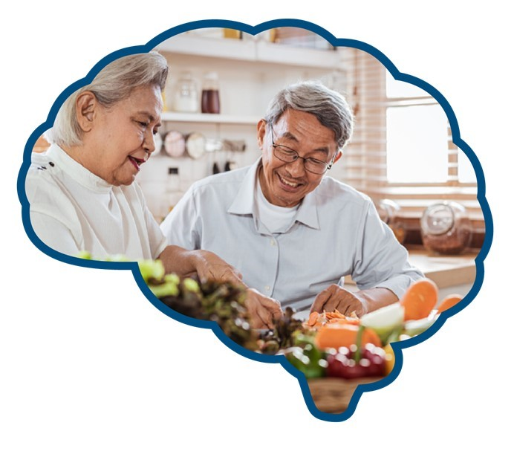
You Are What You Eat (And So Is Your Brain)
The gut-brain connection
Can affect mood, sleep, and brain health
Certain foods can lower the risk of dementia
Notes:
The gut-brain connection: Your gut contains 500 million neurons, similar to your brain cells, which communicate with your brain via the vagus nerve. This communication is called your gut-brain axis.
Can affect mood, sleep, and brain health: Sixty tons of food pass through the intestines of an average human in their lifetime.¹ And if you have ever been on a cruise, you can double that number. What we eat can calm or increase inflammation, help us lose or gain weight, and even improve our brain function. In fact, diet plays a role in essentially every aspect we’ve discussed thus far—our overall brain health, mood, sleep, and productivity, as well as heart, immune, and metabolic health.
Let’s delve into simple things you can do to feed your brain and learn some surprising new insights to get the most benefits from your next meal.

Slide 22
Fruits and Vegetables
Leafy greens like kale, spinach, brussels sprouts. Colorful produce like eggplant, bell peppers, tomatoes, blueberries, strawberries, and blackberries
Fish
Cold water fish: Salmon, herring, mackerel, cod, trout, tuna
Extra Virgin Olive Oil
Nuts
Walnuts, pine nuts, pistachios, and almonds
Beans
Red kidney beans and pinto beans
Notes:
There are a dizzying number of complex, restrictive, and even bizarre diets out there, and new fads or trends in eating pop up seemingly every week. If we cut through the noise, a lot of the research on the connection between diet and brain health improvements point to a Mediterranean-type diet as being the best.
That’s a diet filled with fruits and vegetables, bursting with beans, nuts, and whole grains, and featuring fish, seafood, and good fats like olive oil. The Mediterranean diet lowered the risk of Alzheimer’s even in those with a genetic risk factor for the disease.
A Mediterranean diet is an excellent foundation because it’s easier to follow than many other diets. Diets that are too restrictive aren’t sustainable in the long term for most people. Instead of thinking about limiting the foods you love, think about adding heart- and brain-healthy foods (such as fish, walnuts, and olive oil) and eating both at the same time. I’m not suggesting you just double the amount of food you’re eating—instead, make some key substitutions and additions.
One way to keep it simple is to just double-check whether you have these five items (or most of them) in your actual or virtual shopping cart. If you are consuming a combo of most of these five foods, you are likely going in a great direction:
Fatty fish (such as salmon)
Avocadoes
Nuts
Blueberries
Cruciferous veggies (like arugula, bok choy, broccoli, Brussels sprouts, cabbage, cauliflower, collard greens, kale, and others)
What not to eat: A study published in Neurology followed subjects for twelve years; the results suggest that combining processed meat, such as sausage or cured meat, with a starchy carbohydrate like a potato or sugary snack increases the risk of dementia.¹ You might be saying, “You’re taking away everything that I love to eat!” Don’t despair! In that same study, when people ate heart and brain-healthy foods at the same time as highly processed/sugary foods, it helped lower their risk for dementia.²
[Optional interesting food study: Did you know there’s an unwrapped Twinkie that’s been on display at Chicago’s Museum of Science and Technology since 2009? It still looks good enough to eat, and it probably is. But the additives and preservatives that keep foods like Twinkies from spoiling can wreak havoc on the gut (and the brain!) by increasing inflammation.
Fast food is often filled with additives and preservatives that feed harmful bacteria. A study published in the American Journal of Clinical Nutrition had a group of people eat burgers and fries—a typical fast-food meal. But half the group ate meals prepared with saturated fat, while the other half ate meals prepared with sunflower oil, a healthier fat. An hour after eating the meal, the researchers tested participants’ concentration and focus. The group that ate the meal prepared with the healthy fat scored significantly better on attention tests.
A few weeks later, they brought all the participants back and switched the meal so that the people who’d had the high-saturated-fat meal now ate the meal prepared with sunflower oil, and vice versa. Again, the groups were tested, and those who ate the meal prepared with high saturated fat performed worse on the tests of focus and attention. It’s interesting to think about how quickly the food we eat can impact our brains.³]
If your current diet isn’t in line with protecting your brain, you can begin making small changes for the better. Our workbook provides some simple, easy ways to include some of these healthy foods into your diet.
¹Cécilia Samieri et al., “Using network science tools to identify novel diet patterns in prodromal dementia,” Neurology 94, no. 19 (2020), https://doi.org/10.1212/WNL.0000000000009399.
²Samieri et al., “Using network science tools to identify novel diet patterns in prodromal dementia.”
³Janice K Kiecolt-Glaser et al., “Afternoon distraction: a high-saturated-fat meal and endotoxemia impact post-meal attention in a randomized crossover trial,” American Journal of Clinical Nutrition 111, no. 6 (2020): 1150–1158, https://doi.org/10.1093/ajcn/nqaa085.

Slide 23
The Stress Surprise
Some stress is good
Boost happiness to manage stress
Find the right amount
Notes:
Some stress is good: We hear it all the time: stress is bad. It’s true that too much stress isn’t a good thing, physically or psychologically. So, should we strive to have a stress-free life? While this may be a surprise to some people, the answer is no. Some stress is good for you. The right kind of stress motivates and focuses the brain and can even slow down brain aging.
Beneficial stress is manageable and occurs in a burst, or a moment. Manageable stress cleans up brain trash; it turns on a program called autophagy, which cleans up old, dead cells and removes waste and toxins, keeping your body clean and young. Think of a challenge you want to tackle or something that makes you nervous—that’s the type of stress that grows new brain cells in the hippocampus. Just like a car, if you don’t “drive”—if there’s no stress at all—it falls apart. On the other hand, if you keep asking it to overperform—if you’re constantly on edge—it will break down.
Boosting happiness can help manage stress. Boosting happiness minimizes and lowers anxiety, depression, and pain symptoms.¹ Even small increases in happiness extend longevity.² It’s not easy to completely define what happiness is, but it can generally be defined as being in a good mood, having positive emotions and enjoyment, and being satisfied with life. Research found the risk of dying due to any cause lowered by 19 percent for happy older people.³
Find the right amount: Here’s the big question: How do we find just the right amount of stress to keep our brains and immune systems running like finely tuned Ferraris? We’ll talk about some ways to do that next.
¹Louise T. Lambert D’raven, Nina Moliver, and Donna Thompson, “Happiness intervention decreases pain and depression, boosts happiness among primary care patients,” Primary Health Care Research & Development 16, no. 2 (2015): 114–126, https://doi.org/10.1017/S146342361300056X.
²Choy-Lye Chei et al., “Happy older people live longer,” Age and Ageing 47, no.6 (November 2018): 860–866, https://doi.org/10.1093/ageing/afy128.
³Chei et al., “Happy older people live longer.”

Slide 24
Rose, Thorn, Bud
Breathing Exercise
Change Your Perspective
Notes:
A study found that stress and unhappiness can be caused by our minds wandering. Why? When our minds wander, they wander to unhappy, stressful, and anxious thoughts. Much of that stress comes from worrying about the past or the future; the key is being present and in-the-moment, which is associated with greater happiness and less stress.
One way to be present and manage stress is to practice mindfulness. Before we learn how, let’s look at a Harvard study that took people who had never practiced mindfulness and had them do it for eight weeks. The study took pictures of participants’ brains before they started, during the eight weeks, and after the eight weeks.¹
After practicing about thirty minutes of mindfulness a day for eight weeks, the participants’ brains changed. The hippocampus, the part of your brain that allows you to learn new things, grew. The prefrontal cortex, the brain part that calms your stress response, got stronger and larger, and the amygdala, which manages our fight-or-flight stress response, shrank.
People who practiced mindfulness still had stress, but they were better able to control and manage it. This highlights that we have the power to change our brains, mood, and how we respond to stress.
Breathing Exercise There are many mindfulness exercises, some of which involve breathing, some of which don’t. If you like breathing exercises, here’s a simple and effective one that can be done any time you have a spare minute. (We cover a couple mindfulness exercises that don’t involve breathing below.)
Say to yourself, or out loud: “Breathe in calmness, breathe out anxiety”
On the “breathe in calmness,” inhale through your nose
On “breathe out anxiety,” exhale through your mouth
Try to focus only on the breath going in your nose and out of your mouth
If you’re having trouble getting in the present moment, place your hand on your stomach and focus on breathing for five seconds. Feel the rise and fall of your abdomen with each breath.
If your mind wanders, that’s normal. Don’t be upset or stressed. Instead, gently try to bring it back to focus by using a word such as breath or focus. It sounds simple, but for many people, it’s harder than it looks. If thirty seconds feels like thirty minutes, don’t feel bad; it can take some practice. If you can do thirty seconds, be proud of yourself, and tomorrow try to add another thirty seconds. Think of it like going to the gym and working up reps.
Change Your Perspective Two people might experience the same stressful situation but have very different responses. Stress can actually be quite useful—and you can train your brain to view stress in exactly that light.
Even a bit of stress from sitting in traffic or standing in line at the grocery store can be beneficial.² These bursts or moments of acute stress can be healthy for the brain for a variety of reasons; for instance, a quick dose of cortisol can turn on the process of autophagy, which cleans up waste and toxins. So next time you’re in the “10 items or less” lane at the grocery store and the person in front of you has 37 cans of cat food and 37 different coupons, don’t curse them. Thank them—and by doing so, shift your perspective on stress as something that can be beneficial.
Rose, Thorn, Bud Take a moment and think of the best thing that happened from the last twenty-four hours. That’s your rose. Next, think of the most challenging part of the previous twenty-four hours. That’s your thorn. Now think of something specific you are looking forward to in the next twenty-four hours. That’s your bud. This technique has been shown, in a 2019 study, to be an effective means to manage stress and boost happiness.³
We can’t control much of the stress surrounding us, but day by day, we can build connections in our brains to be closer to being experts in happiness and managing stress.
¹Rodger A. Liddle, “Parkinson’s Disease from the Gut,” Brain Research 1693, pt. B (2018): 201–206, https://doi.org/10.1016/j.brainres.2018.01.010.
²B. O. Osuntokun et al., “Lack of an association between apolipoprotein E epsilon 4 and Alzheimer’s disease in elderly Nigerians,” Annals of Neurology 38 (1995): 463–465, https://doi.org/10.1002/ana.410380319; R.N. Kalariaet al., “Evaluation of Risk Factors for Alzheimer’s Disease in Elderly East Africans,” Brain Research Bulletin 44, no. 5 (1997): 573–577, https://doi.org/10.1016/S0361-9230(97)00310-9; Hugh C. Hendrie et al., “Incidence of Dementia and Alzheimer Disease in 2 Communities: Yoruba Residing in Ibadan, Nigeria, and African Americans Residing in Indianapolis, Indiana,” JAMA 285, no. 6 (2001): 739–747, https://doi.org/10.1001/jama.285.6.739.
³Eva Schelbaum et al., “Association of Reproductive History With Brain MRI Biomarkers of Dementia Risk in Midlife,” Neurology 97, no. 23 (2021), https://doi.org/10.1212/WNL.0000000000012941.

Slide 25
Get Moving
Improves memory and lowers risk of dementia
Small changes can make a big impact
Boosts brain cell communication
Notes:
Exercise is like a miracle drug for the brain. While you’re not going to show off your hippocampus in a tank top, if a drug generated the brain benefits that exercise produces, there would be lines stretching miles long to obtain it.
Lowers Risk of Dementia
A study at Cardiff University in the UK followed thousands of people for over thirty years and found that simply walking thirty minutes a day lowered the risk of dementia by about 65 percent.¹ The best part? Those thirty minutes didn’t even have to be done consecutively.
These results were replicated in a startling study published in Neurology.² The study asked fifty-year-old women to work out on an exercise bike, then placed them in four categories depending on how long they could work out. The categories ranged from “high physical fitness” (most fit) to “could not finish the fitness test.” After four decades, the researchers found:
5 percent of the women in the high physical-fitness category developed dementia.
25 percent of the women in the moderate and low fitness categories developed dementia.
45 percent of women who couldn’t finish the fitness test developed dementia.
That means that women who were classified as highly physically fit at fifty years old were 90 percent less likely to develop dementia than the group that could not finish the test, decades later.
Improves Memory
A study published in the Journal of Alzheimer’s Disease investigated two groups of adults sixty and older. One group did a year of aerobic exercise, and the other group just stretched. The group that did aerobic exercise showed a whopping 47 percent average increase in memory scores after that year, while the stretching group didn’t see an improvement in memory.
Small Changes Can Make a Big Difference
Here comes the big question: How much exercise do you need to do to protect your brain and keep it plump? Do you need to drop everything and train for a triathlon? Fortunately, no. It turns out even small changes can have a big impact.
The next time you are given a choice between stairs and an elevator or escalator, consider this; a 2016 study found that people aged nineteen to seventy-nine who consistently took the stairs rather than an escalator or elevator had a younger-looking brain.³
Boosts brain cell communication
There is a mountain of evidence that exercise makes your brain cells communicate with each other more effectively at any age.⁴ That increased brain communication can improve mood and boosts happiness.⁵
Let’s discuss some other exercise tips to help keep your brain young.
¹Peter Elwood et al., “Healthy Lifestyles Reduce the Incidence of Chronic Diseases and Dementia: Evidence from the Caerphilly Cohort Study,” PLOS One (2013), https://doi.org/10.1371/journal.pone.0081877.
²Helena Hörder et al., “Midlife cardiovascular fitness and dementia,” Neurology 90, no. 15 (2018), https://doi.org/10.1212/WNL.0000000000005290.
³Jason Steffener et al., “Differences between chronological and brain age are related to education and self-reported physical activity,” Neurobiology of Aging 40 (2016): 138–144, https://doi.org/10.1016/j.neurobiolaging.2016.01.014.
⁴Richard J. Maddock et al., “Acute Modulation of Cortical Glutamate and GABA Content by Physical Activity,” Journal of Neuroscience 36, no. 8 (2016): 2449, https://doi.org/10.1523/JNEUROSCI.3455-15.2016.
⁵Wittfeld et al., “Cardiorespiratory Fitness and Gray Matter Volume in the Temporal, Frontal, and Cerebellar Regions in the General Population”; American Academy of Pediatrics, “Combining physical activity with classroom lessons results in improved test scores,” Science Daily, July 1, 2011, https://www.sciencedaily.com/releases/2011/05/110501183653.htm; Zhanjia Zhang and Weiyun Chen, “A Systematic Review of the Relationship Between Physical Activity and Happiness,” Journal of Happiness Studies 20 (2019): 1305–1322, https://doi.org/10.1007/s10902-018-9976-0.

Slide 26
Make Exercise a Habit With CARS
Cue: Setup visual reminders
Action: e.g., Park farther away
Reward: Do something you enjoy
Support: Find a workout buddy
Notes:
At this point, you might be saying, “I get it! Exercise is good for my brain. But if the key to any exercise plan is consistency, how do I stay with it? How do I make exercise a habit instead of that exercise bike or treadmill becoming a very expensive coatrack?”
Making Exercise a Habit: CARS (Cue, Action, Reward, Support)
Cues
When it comes to making exercise a habit, incorporate exercise into our default or autopilot mode—this makes exercise easier for us. We can set up a cue that drives us to take action to stick to an exercise program.
Here are two cue suggestions: Simply place your walking shoes where you can’t miss seeing them as a reminder to take your daily walk. Another visual cue can be to wear a smartwatch that reminds you of your steps.
Action
When it comes to exercise, it’s best to start small and build.
For example:
Walk in place during TV commercials or before the next episode of what you’re streaming
Stand and/or walk during phone calls
Park farther away from the grocery store
Do ten jumping jacks every hour (you can set your smartphone to remind you to do this)
Reward
Exercise has to be fun and rewarding, or your brain will likely not make it a habit. This is why pairing the exercise habit with something you already love doing can be very helpful. Have you heard someone say, “I walk on the treadmill every single day, and I hate every single second of it?” If you enjoy working out on a treadmill, that’s great, but if it’s drudgery, ditch it and look for a new and enjoyable experience, as newness and novel environments are keys to focus and memory. Try hiking new trails by a lake or just walking in a new neighborhood. Learn a new sport and have fun doing it.
The body can acclimate to the same activity, and results diminish. The same is true with the brain. Try to keep your workouts fun and fresh. There are endless virtual workouts online and classes at local libraries that teach yoga, dance, Pilates, and tai chi.
Support
A study found that active participation on a sports team had brain-health benefits.¹ It wasn’t just the playing but also the socializing that boosted the brain. Find a workout buddy or join a sports team or exercise class.
Penn Jillette of the magic duo Penn and Teller lost a hundred pounds. To keep himself motivated, he used a brain trick that would terrify most people. At the beginning of his weight-loss journey, he posted his weight on social media every day. That may sound horrifying to you, but that accountability kept him motivated.
Be aware, though, you’re going to have good days and bad days when you’re establishing your exercise habit. Stick with it. If a forty-minute walk is too much to fit in, even three short (think ten- to fifteen-minute) walks a day can reap significant brain benefits. Each day you stick to the habit, you are building and strengthening the connections between brain cells that the habit establishes in your brain. Through repetition, those connections will get stronger and stronger, and a healthy habit will be formed. And remember: there’s overwhelming evidence that exercise not only slows down and reverses brain age, but it can also improve the way your brain works each day.² The secret to a healthy brain is just a couple (or few thousand) steps away each day.
¹Hans-Peter Hutter, “The Sports Club as a Health Driver” (presentation, European Forum Alpbach, August 22, 2017). ²Laura D. Baker et al., “High-Intensity physical activity modulates diet effects on cerebrospinal β-amyloid levels in normal aging and mild cognitive impairment,” Journal of Alzheimer’s Disease 28, no. 1 (2012): 137–146, https://doi.org/10.3233/JAD-2011-111076; Laura D. Baker et al., “Effects of aerobic exercise on mild cognitive impairment: a controlled trial,” JAMA Neurology 67, no. 1 (2010): 71–79, https://doi.org/10.1001/archneurol.2009.307.

Slide 27
Cross Training Your Brain
Norepinephrine takes out the trash
Myelination speeds up processing
Embrace that feeling of frustration
Notes:
Norepinephrine: Hopefully, in today’s presentation, you’ve learned some new information. That very action was protecting your brain: learning new information plays a significant part in disposing of brain trash via a “power wash” that uses one of your body’s most effective brain cleansers: norepinephrine.¹
Norepinephrine is a hormone and neurotransmitter that regulates heart rate, attention, memory, and cognition.² When you learn something new, your brain squirts norepinephrine from a brain structure called the locus coeruleus.³ The norepinephrine breaks up the waste and trash in your brain so it can be excreted when you sleep. This keeps your brain young, healthy, and able to make new connections.
Maintaining a healthy brain and strong memory is not all about Sudoku, crossword puzzles, and brain games. Those can be fun, and they can have a brain benefit, but they aren’t the only things we can and should do to exercise the brain. What does make significantly new connections (synapses) in our brain is learning new skills and acquiring information; the more connections you make, the more likely you are to retain and even enhance your memory.
Study after study has found that learning new things significantly lessens the risk of memory loss and slows down brain aging.
Myelination: As you learn new things, you add myelination, a coating around your brain cells that makes the electrical signals travel faster. It’s similar to the insulation you see on an electrical wire. This myelination allows us to get better at tasks—and adds weight to the brain. The thicker the myelin coating gets, the better and faster you’re able to learn new things.
Embrace that feeling of frustration: Learning a new language or a musical instrument is good for your brain. A study found that being bilingual or a musician at any age made the brain more efficient in day-to-day memory tasks.⁴ But to get a real good spray of norepinephrine, make the new information challenging. Embrace that feeling of frustration when you learn something new and outside your field of expertise.
¹Mara Mather and Carolyn W. Harley, “The Locus Coeruleus: Essential for Maintaining Cognitive Function and the Aging Brain,” Trends in Cognitive Sciences 20, no. 3 (2016): 214–226, https://doi.org/10.1016/j.tics.2016.01.001.
²John O’Donnell et al., “Norepinephrine: a neuromodulator that boosts the function of multiple cell types to optimize CNS performance,” Neurochemical Research 37, no. 11 (2012): 2496-2512, https://doi.org/10.1007/s11064-012-0818-x
³Mather and Harley, “The Locus Coeruleus”
³Mellanie V. Springer et al., “The Relation Between Brain Activity During Memory Tasks and Years of Education in Young and Older adults," Neuropsychology 19, no. 2 (2005): 181-192, https://doi.org/10.1037/0894-4105.19.2.1816.
⁴Claude Alain et al., “Different neural activities support auditory working memory in musicians and bilinguals,” Annals of the New York Academy of Sciences 1423, no. 1 (2018), 435-446, https://doi.org/10.1111/nyas.13717

Slide 28
Learn Something New
Mix it up
Try different physical activities
Learn a new song to sing or play
Try your hand at a new language
Read a book on a subject you’re not familiar with
Socialize with friends and meet new people
Notes:
Mix it up
When you think about learning something new, approach it the way you would fitness training. For instance, you wouldn’t go to the gym and only work out your forearms. (Eventually, you would look like Popeye.) You want to work out different muscles on different days and work on your aerobic fitness as well as building muscle.
The same goes for the brain. Learning a language works out different parts of the brain than sports and music do. You can cross-train your brain by mixing mental and physical learning activities.
Over the course of a week, for example, play tennis, golf, pickleball, or soccer; learn a new song to sing or play; and try your hand at a new language or read a book on a subject you’re not familiar with.
When you socialize with others, your brain is challenged to process new information, understand different perspectives, and communicate effectively. This can improve your brain health, including your memory, attention, and problem-solving skills.
The key take-home message is that learning new information or a new skill keeps your brain young. So, since you’re learning something new by being here today, you’re doing one of the most important things for your brain.
[Optional: Try the Pomodoro Method
This time management technique was developed in the late 1980s. To try it, first, eliminate all distractions: silence your cell phone and put it out of sight. Silence the alerts on your computer. No websites open in the background. No checking email, the score, or social media. Set a timer (not on your cell phone!) for twenty minutes and focus on just one important task. If your mind wanders, bring it back to your task. Commit to twenty minutes of distraction-free work.
If you make it, be happy for yourself and consider that one rep. Take a five-minute break and do it again. If you are having trouble reaching the twenty minutes without a distraction, try just ten minutes, and each day you are successful, try increasing the amount of time until you hit twenty minutes of pure focus. You can definitely go past twenty minutes if you find yourself in the zone. Again, think of this as if you were in the gym: increase the time and number of reps—periods of targeted focus—and get stronger and grow your prefrontal cortex. There’s no magic formula for the number of reps you need to do, as it’s based on how much work you need to get done that day. You can determine how many reps you need to do a day.
Don’t forget that five-minute break, though. A 2011 study looked at the benefits of distraction. Participants in the study were separated into two groups. One group focused on a task for fifty minutes with no breaks; the other group took two breaks, one every twenty minutes. The group that took the two breaks within the fifty minutes remembered more about the task.¹ It seems your brain needs a little distraction to re-engage focus; it can be as simple as standing up and walking around the room or a quick stretch.]
¹Atsunori Ariga and Alejandro Lleras, “Brief and rare mental ‘breaks’ keep you focused: Deactivation and reactivation of task goals preempt vigilance decrements,” Cognition 118, no. 3 (2011): 439–443, https://doi.org/10.1016/j.cognition.2010.12.007.

Slide 29
What about Supplements?
Notes:
There’s a lot of conflicting information about supplements for a few key reasons:
The FDA does not tightly regulate supplements; thus, it can be challenging to know what’s actually in the supplement and how much of the promised ingredient is present.
Supplements can be classified as products that may support health as long as they haven’t been proven to cause damage. (That’s a loophole that needs to be fixed.)
Often the studies on supplements are funded by the company making the supplement or include just a small number of people.
The use of any supplements should be discussed with a personal physician. That said, there are a few supplements to consider for the health of your brain—and some you can skip.
When deciding whether to add a supplement to your daily regimen, get your numbers first! If your values are already in normal ranges, you might not benefit from adding those pills and capsules. At your next doctor’s visit, ask about a blood test to check these key factors:
Folate
Vitamin D
Vitamin B-12

Slide 30
Your Age vs. your Brain’s Age
Your Brain May Not Be the Same Age as You
The Importance of Brain Health
How it can impact your finances and lifestyle
How to Age-Proof Your Brain
Jump-start brain healthy habits
© 2023 by Hartford Funds
Notes:
To summarize, today we discussed [read slide]
30

Slide 31
“A sharp mind into older age isn’t just a bit of luck—it’s within reach for most of us”
Marc Milstein, PhD
© 2023 by Hartford Funds
Notes:
Here’s the bottom line. (read slide)
Your brain changes all the time. Because your brain is malleable, you can make it more robust and more adaptable at any age to improve memory, manage stress, and boost focus and productivity. You can also transform your brain at any age to adopt new habits, gain perspective, and recover from physical and mental trauma. The great hope of life is that we are always a work in progress, able to get better and be better each day as our brain remodels.

Slide 32
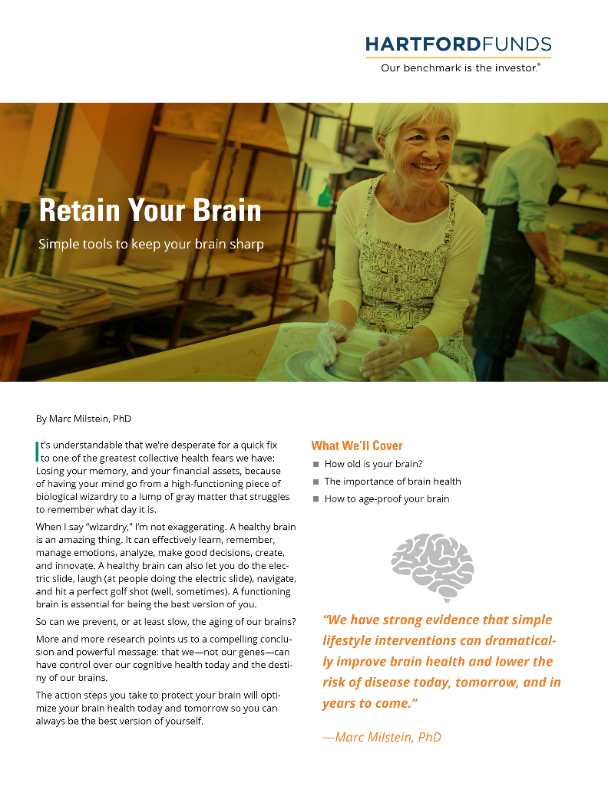
Next steps
Get a copy of our workbook
Within a week, choose an area and start using tips: Sleep, diet, stress, exercise, or learning
Talk to your financial professional about any financial issues related to brain health
The views and opinions expressed herein are those of the author, who is not affiliated with Hartford Funds. If you are concerned about your brain health or cognitive function, it's a good idea to speak with your doctor or a healthcare professional, who can evaluate your cognitive function and provide recommendations for management and treatment, if necessary.
Hartford Funds Distributors, LLC, Member FINRA. SEM_Brain 0423 2845410
Workbook MAI384
Notes:
Read slide
32

