Slide 1
Family Money Talks
^{Transfer wisdom,} ^{not just wealth}
Created in collaboration with Kathleen Burns Kingsbury, founder of KBK Wealth Connection
©2023 Hartford Funds
Notes:
Good morning/afternoon everyone. My name is __________, and I’m a __________ with Hartford Funds. Thank you for taking time out of your schedule to be here today.
Today we will discuss family money talks and the importance of sharing your values, wishes and plans with the next generation. This could include children, nieces, nephews, and/or a younger mentee/beneficiary in their life.
In today’s seminar, you’ll learn what a family money talk is (hint: it's not just about the money), how to engage in productive conversations about wealth, and how to invite next generations into the dialogue.
[Presenter: This presentation is for all types of families so make sure you use inclusive language and specific in the opening that family money talks can include parent(s)/child, aunt/uncle/niece/nephews, queer families, and/or someone with a younger mentee/beneficiary in their life. We want all types of individuals and families to feel welcome.]

Slide 2
Kathleen Burns Kingsbury
Wealth psychology expert, author, and coach
Passionate about breaking money silence
©2023 Hartford Funds
Notes:
We collaborated with Kathleen Burns Kingsbury of KBK Wealth Connections to create this workshop and share these insights with you.
Kathleen founded KBK Wealth Connection to help empower women, couples, and families (and the financial professionals who serve them) to shatter money taboos and communicate more effectively about financial matters.
Kathleen hosts the award-winning Breaking Money Silence® podcast and is the author of several books, including Breaking Money Silence: Shatter Money Taboos, Talk Openly about Finance, and Live a Richer Life.

Slide 3
What’s your favorite family recipe?
©2023 Hartford Funds
Notes:
What is your favorite family recipe? [Presenter, have one of your own to share.]
Think about who first made you this special dish and then taught you how to make it? Many of these family recipes are passed down for generations. Families look forward to the recipe on holidays or special occasions, when everyone raves about it. Perhaps you didn’t ask for the recipe but were instead told about it when your parents, grandparents, or an aunt or uncle decided it was time—maybe when you started to cook or had a family of your own.
Chances are you’ll do the same with your kids, grandkids or nieces and nephews. It’s something families do to help the next generation to carry on the family legacy.
But what about your family’s money recipe? Do you know what it is? Is it discussed openly, and shared with the next generation to learn about finances and financial lessons? If your answer is yes, congratulations! You’re the exception, because most families struggle to talk about money and pass down important financial lessons to younger generations. If only it was as simple as sharing a favorite family recipe.
Today we are going to help you create a recipe for family money conversations.

Slide 4
Agenda
What a family money talk is
Three types of intelligence
How to begin a family money talk
©2023 Hartford Funds
Notes:
In this seminar you’ll learn… [read slide].
Let’s get started.

Slide 5
What a Family Money Talk Is
©2023 Hartford Funds
Notes:
First, what a family money talk is.

Slide 6
Family Money Talks
Conversations with family members about your thoughts, feelings, and beliefs about money and its purpose in your life
©2023 Hartford Funds
Notes:
Many families dread talking about money, and your family may be no exception. But there's a way to talk about money without discussing assets or dollar amounts. It's called a family money talk.
A family money talk can be much broader than many people realize, and it usually doesn’t start with the assets. Instead, these conversations can range from financial fundamentals to family members’ thoughts, feelings, and beliefs about money and its purpose in their life. These conversations are a way to communicate your values and share why you made the financial decisions you have, and what you’ve discovered. It also allows family members to ask questions and learn from both your successes and mistakes.
Family money talks are designed to help families avoid passing wealth to the next generation without the wisdom to manage it.

Slide 7
Estate Planning
Family Money Talks
vs.
©2023 Hartford Funds
Notes:
Estate planning is certainly important, but its function is much different from family money talk.
An estate plan is a legal document ensuring that when you die your assets go to the people you chose, and helps minimize income, gift and estate taxes.¹ Part of a comprehensive financial plan, an estate plan protects your heirs and other family members from probate court, costly legal battles, and confusion about your intentions.
It’s been reported that only 33% of Americans have an estate plan.² If you’re one of the 33%, congratulations! You’re on the right track. However, there is something an estate plan doesn’t do: It doesn't transfer wealth wisdom. That’s the role of family money talks.
Family money talks are conversations about your values and the meaning of wealth in your life. They also include teaching the next generation to be financially savvy and responsible so that when the time comes, they can sustain family wealth across generations.
Having an estate plan and family money talks is the recipe for success. However, the challenge for many families is that talking about money may be taboo.
¹What is estate planning and why is it important? nationwide.com, retrieved 4/23
²67% of Americans have no estate plan, survey finds. Here’s how to get started on one, cnbc.com, 4/22

Slide 8
The Money Talk Taboo
67%
of affluent Americans haven’t talked to their children about wealth or never will¹
¹4 Reasons Parents Don’t Discuss Money (and Why They Should), nytimes.com, 8/19
©2023 Hartford Funds
Notes:
Most of us would agree talking to family and other loved ones about money is important. Then why don’t families have these conversations? Oftentimes, it’s the money talk taboo.
[Optional: There isn’t a single money taboo that exists across every segment of American culture, but a few examples are:
Being taught that talking about money is impolite
Shame about having/earning more or less than someone else
In America, asking someone what they earn is considered taboo because it’s indirectly questioning their personal worth¹
(Presenter can use example from their own experience)]
Sixty-seven percent of affluent Americans (i.e., having three million or more in investable assets) haven’t talked to their children—or will never talk to them—about their wealth.² This leaves the next generation unequipped to inherit wealth and manage it responsibly.
It’s tempting to avoid family money talks, especially if you were raised with money talk taboos. But this can be dangerous.
[next slide]
¹Why So Many Americans Don’t Talk About Money, theatlantic.com, 3/20
²4 Reasons Parents Don’t Discuss Money (and Why They Should), nytimes.com, 8/19

Slide 9
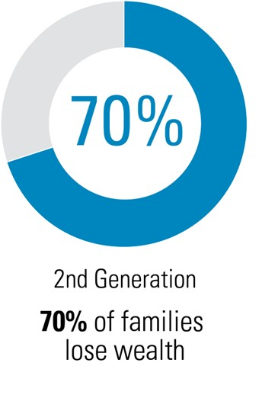
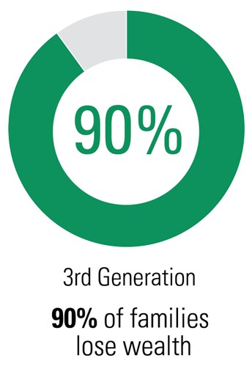
This Can Put Family Wealth at Risk
1
1
¹5 Huge Lies About Generational Wealth, finance.yahoo.com, 1/22
©2023 Hartford Funds
Notes:
One reason is that it puts family wealth at risk.
Maybe you heard the adage, “The first generation makes it, the second generation spends it, and the third generation blows it.” Believe it or not, research shows it’s often true.
[read slide]
It’s not surprising that if money conversations aren’t taking place that this is the result.¹ Without the wisdom to manage it, an inheritance may be spent quickly without any means of recovery. Even worse, families may implode, with members fighting amongst each other, going to court, or no longer speaking to one another. Still, why do families hesitate to talk about money, even privately among themselves?
¹5 Huge Lies About Generational Wealth, finance.yahoo.com, 1/22

Slide 10
Common Myths About Holding Family Money Talks
The next generation will become unmotivated and entitled
We’ll lose control of our finances
It’ll change our relationship
©2023 Hartford Funds
Notes:
Myths are partly to blame.
There are many common myths that contribute to families, specifically parents, not talking to their children about money. Here are just three of them. [read slide]
If only assets are discussed, these are possibilities. But if the family money talks approach is used, these outcomes are less likely.
[Presenter: More details are below, if needed.]
Myth: Our children will become unmotivated and entitled.
Fact: Family are an opportunity to instill a good work ethic and appreciation for financial success in our children. If we’re silent, we lose that opportunity.
Myth: We’ll lose control of our finances.
Fact: While losing control is a common worry as we age, the purpose of family money talk is not to hand over the reins on our financial lives. As a parent, you get to choose what you want share and when you want to share it. The conversation isn’t about relinquishing your power. Instead, its about communicating your values, wishes, and hopes for the future.
Myth: It’ll change our relationship.
Fact: Again, if wealth conversations focus solely on assets, then it could impact your relationship. But that’s not what money talks are for.
Now let’s look at the truth about having family money talks.

Slide 11
Benefits of Family Money Talks
Help the next generation to be financially fit
Discuss family members' values and hopes for the future
Transfer wisdom, not just wealth
©2023 Hartford Funds
Notes:
[read slide]
Overall, a family that has money talks regularly has greater financial wellbeing and is more successful in passing on wealth to the next generation.
How many of you think this is a good idea? (Ask participants for a show of hands, then transition to the next slide.)
If you’re unsure about engaging in family money talks, let’s see what happened when a parent avoided these conversations with her heirs.

Slide 12
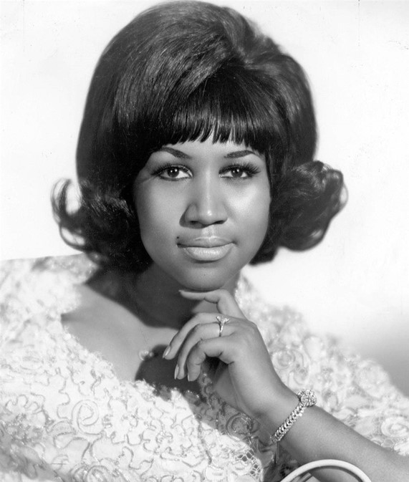
The Reality of Not Having Family Money Talks
©2023 Hartford Funds
Notes:
Unfortunately, there are many stories of families that didn’t have family money conversations that resulted in disaster—including family fighting and legal battles.
Who knows who this is? (Wait for audience to respond.) It’s the “Queen of Soul,” Aretha Franklin. She died at 76 in 2018, without a formal written will. Apparently, she didn’t talk about finances, her values, or her future wishes with her children before she passed.
When Ms. Franklin died, her four sons were confused about her intentions for passing down her wealth. Unfortunately, this resulted in a three-year court battle between the siblings. It’s doubtful that she wanted her family to be engaged in conflict, pay high legal fees, or lose a sizable portion of their inheritance to taxes. But her silence ended up costing her family emotional pain and financial hardship.
The value of Ms. Franklin’s estate hasn’t been determined, but some estimates range as high as $80 million.¹ It’s been reported that her sons received $200,000 from her estate, but their legal battle continues.² This is an extreme example, but it highlights why family money talks and proper planning are vital for the future of your loved ones. Even if the thought of having them is a little uncomfortable.
Now that you understand the importance of family money talks, let’s look at three key ingredients of your family money talk that, when added together, can help equip children and heirs for the future and their financial wellbeing.
¹Aretha Franklin’s Estate Signs Tentative Deal Over Back Taxes Owed, nytimes.com, 3/21
²Who Inherited Aretha Franklin’s Money After She Died, 3/22

Slide 13
Three Types of Intelligence
©2023 Hartford Funds
Notes:
[read slide]
It may surprise you that there are three specific types of intelligence that contribute to financial health.
And here they are.
[next slide]

Slide 14
Financial
Intelligence
Emotional
Intelligence
Family
Intelligence
©2023 Hartford Funds
Notes:
These intelligences are financial intelligence, emotional intelligence, and family intelligence.
When you think about it, if knowledge alone was necessary to achieve and maintain wealth, many, many more people would be millionaires. And those who were millionaires wouldn’t go bankrupt. Think of lottery winners who became multi-millionaires overnight. Their stories often end in tragedy.
That’s why the most successful wealth transfers happen when both the technical and the human side of finance—which includes these intelligences—are discussed with the next generation.
Let’s take a closer look at financial intelligence.
[next slide]

Slide 15
Financial intelligence Knowledge and skills that enable us to make wise financial decisions that build and sustain wealth
©2023 Hartford Funds
Notes:
The first ingredient is financial intelligence. This is a person’s financial knowledge and skills that enable us to make prudent financial decisions that build and sustain wealth.
The building blocks of financial intelligence fall into six categories.
[next slide]

Slide 16
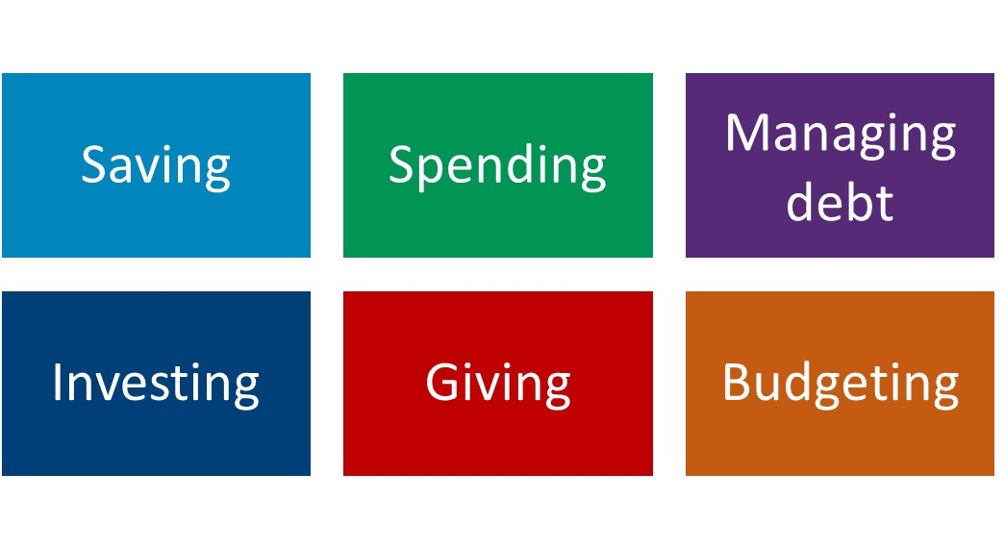
Financial Intelligence Building Blocks
©2023 Hartford Funds
Notes:
[read categories on slide]
Not everyone is taught these foundational skills, and perhaps you learned some of them on your own. You may not be an expert in all six areas of financial intelligence. But you likely have years of valuable learning to share that include success stories and hard lessons.
Let’s see how you can share that wisdom with your kids and maybe learn something from them, too.

Slide 17
Financial Intelligence Exercise: Share a Related Story
Your biggest regret
Your best decision
A funny situation
An important lesson you learned
©2023 Hartford Funds
Notes:
The financial intelligence exercise involves sharing a story with your kids, based on one of the six categories. If it sounds simple, it is.
I’ll go first to show you how. [Presenter: Share a story of your own.]
Now, it’s your turn to practice. Are you ready?
1. Take a moment and think about those six categories on the previous slide: Saving, Spending, Managing debt, Investing, Giving, and Budgeting. Is there a story or experience you could share that’s related to one?
2. Your story could be about [read slide]. Or it could be about a triumph over a challenge, a story of resilience, or a changed perspective.
3. Is there a story you could briefly share? If it helps, think about the following framework:
What happened
How you responded and what you did
What you learned
What difference it made
I.e., what did you learn from the experience? Did it shape how you handle your finances today?
[Presenter: Ask if anyone in the audience would like to share what they discovered.]
Remember, you can be open with your children about financial mistakes you’ve made, or hardship you’ve faced. As a result, you may have developed greater self-discipline, become more resourceful and resilient. These experiences have great value; your children can learn from them. One of parents’ main goals is to raise responsible and self-sufficient adults and learning from our real-world experiences—positive or negative—is a way to accomplish that.
Next, let’s look at emotional intelligence.

Slide 18
Emotional intelligence Awareness of how our emotions influence our financial decisions and behaviors
©2023 Hartford Funds
Notes:
Next is emotional Intelligence. Emotional intelligence, as it relates to finances, is understanding your relationship with money, particularly awareness of how our emotions influence our financial decisions and behaviors
This develops awareness of the choices we and the next generation make and why we make them. This is especially important because it allows us to understand our emotions and manage them accordingly, without letting them rule your thinking and behavior.
Because managing wealth requires more than just knowledge, foundational financial skills are even more powerful when combined with emotional intelligence.

Slide 19
Emotional Intelligence Exercise: Complete Each of These Thoughts
When I save money, I…
When I spend money, I…
Investing makes me…
When I have debt, I…
Talking about money with my kids (or aging parents) is…
©2023 Hartford Funds
Notes:
Because we avoid talking about money, and especially money and emotions in our society, many of us don’t recognize how our emotions influence our financial behaviors and decisions.
We’re going to do another exercise that will give insight into your thoughts about money and see how those thoughts impact your habits and decision-making. Know that there is no right or wrong way to think, and no two family members or people will have the same thoughts. We each have our own unique life and financial experiences. Let’s get started.
The statements on the slide represent common thoughts about money. I’m going to read each statement and I want you to finish them, writing them down in your own words. [Presenter: Pause for ~15-30 seconds after reading each prompt.]
Next, we’ll look at how the parts of our money thoughts influence your feelings and financial behaviors.

Slide 20
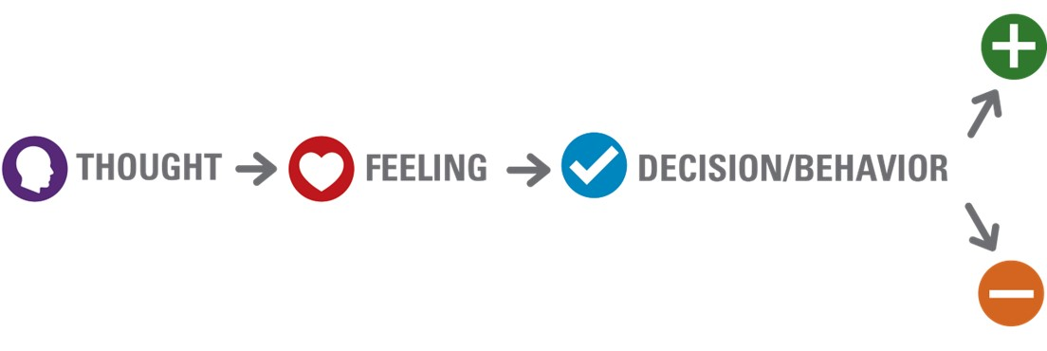
The Connection Between Our Thoughts, Feelings, and Financial Behaviors
Lives debt-free/saves aggressively
Denies self comfort or convenience
Buys lower quality items; spends more money to replace
If you can’t pay cash for something, don’t buy it
Fearful of spending money unnecessarily
Excessively frugal
©2023 Hartford Funds
Notes:
The diagram on the slide illustrates the connection between your thoughts, feelings and behaviors. This process happens so often, and so quickly, that you probably don’t realize that it happens. The benefit of having this awareness is evaluating how your thought serves you or interferes with your financial wellbeing.
For example, if your money thought is, “If you can’t pay cash for something, don’t buy it,” you might be afraid to spend money on anything you feel isn’t necessary.
Again, money thoughts aren’t good or bad—it’s how they influence you and your financial wellbeing that needs to be evaluated.
As you can see on the slide, there are advantages and disadvantages to having this thought. An advantage is living debt-free or having little debt. Sounds good, right? Potential disadvantages are denying yourself creature comforts and buying lower-quality items that will need to replaced sooner, ultimately resulting in spending more money.
1. Now, pick the money thought from the last slide that resonates most with you. For the purpose of this exercise, you may want to pick a money thought that brings up strong feelings.
2. How does that thought make you feel?
3. What do you or not do as a result?
4. What are the pros and cons of this thought?
[Presenter: Ask if anyone in the audience would like to share what they discovered. You can also share your example.]

Slide 21
Family Intelligence Your family history, values, and hopes for the next generation
©2023 Hartford Funds
Notes:
Family intelligence is defined as your family history, values, and hopes for the next generation.
Often values are part of the family history and shape our motivations and aspirations.

Slide 22
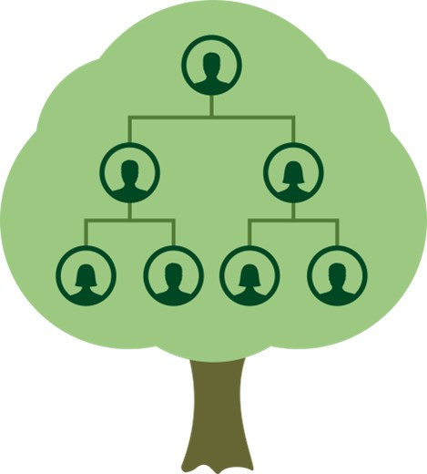
The Family Tree Effect
Is there a money belief you inherited?
Do you embrace it? Resist it?
Did a financial event impact your relationship with money?
©2023 Hartford Funds
Notes:
When it comes to family intelligence, a natural place to start is with your family tree.
[Optional: Read and discuss bullets. Share a personal story about a belief you inherited. If time allows, ask an audience member to share an inherited belief.]
Our relationship with money doesn’t just happen on its own. It’s largely influenced by our family history.
When you were young or growing up, you:
Heard messages about money
Observed things about money
Had experiences with money
And if you were lucky, were taught how to manage money
All these observations and experiences influence how you think, feel and act around money as an adult. Similar to how family recipes are passed down from one generational to the next, family money messages are passed down. In adulthood you get to decide which of these messages help you and which ones you want to let go.
[Presenter: Read the slide and ask the audience to ponder their answers. You can also share your own.]
One outcome of the family tree effect involves values. That’s the focus of our next exercise.

Slide 23
Family Intelligence Exercise: Identify Three Core Values
Adventure
Career/work
Community
Creativity
Ecology/environment
Self-improvement
Family
Freedom
Friendship
Health & fitness
Helping others
Independence
Leadership
Learning & education
Philanthropy
Play/pleasure
Power
Religion/spirituality
Security
Service
Travel
©2023 Hartford Funds
Notes:
Another aspect of family intelligence is identifying and discussing family values. Often values are part of the family history that give context to money beliefs and behaviors.
Let’s do our last exercise.
1. Scan the list of core values, writing down any that represent what’s important to you. Take two minutes to do this and go with your gut. There are no right answers, so don’t overthink it.
2. Next, review the values you jotted down and narrow down your top three.
3. Now, turn to the person next to you and:
Share one of the top three values you identified
Briefly explain why this value is important to you
[Presenter: Ask if anyone in the audience would like to share their core values and why they’re important. You can also share your own.]
Next, you’ll consider how your money decisions reflect your core personal values.
[next slide]

Slide 24
How Do You Honor Your Values?
©2023 Hartford Funds
Notes:
Now that we’ve identified our values, let’s explore if we honor those values with how we spend, save, invest, or gift money?
[Presenter: Share personal story about how you honor your top values. Ask if anyone would like to share with the audience.]
You can use this exercise to begin a discussion with family members about what’s important to them.
How were these values formed?
How can they use money to express these values?
While some families use philanthropy as a tool for teaching the next generation about wealth and passing on their core values, other families may identify and teach values in a different way. Examples include a family that loves adventure may travel with their kids to show them the world and share adventures together. Or a family that is spiritual may attend services together and take an active role in their spiritual community.
Talking about values is a non-threatening way to begin a productive family money talk.

Slide 25
How to Begin Family Money Talks
©2023 Hartford Funds
Notes:
Now that you understand what a family money talk is and the three types of intelligence you want to instill in the next generation, let’s look at how you can use this information to start a family money talk with confidence.
By the way, we have a workbook that contains the information and the exercises we’ve already covered, as well as these action steps, in more detail. So don’t worry about trying to remember everything. Your workbook will include everything you need to get started.

Slide 26
Step 1: Introduce the Idea
We went to a workshop that teaches families how to have productive conversations about money
We realized that we haven’t always talked about money in a helpful way and think it’s important that we start
We’re interested in your thoughts and ideas about money too
©2023 Hartford Funds
Notes:
[Optional: Depersonalize with a stat or news headline. “I read a story about Aretha Franklin…”]
Tell your adult kids you attended an interesting seminar that taught families how to have productive conversations about money. It changed your perception of what it means to talk about money and why it’s so important. It was actually fun, and you’d like to tell them a bit about what you learned. The intention is to have a dialogue, and you’d like to hear their thoughts and ideas about money too.

Slide 27
Step 2: Explain the Purpose
What It Is
What It Isn’t
Share what you learned to help improve family communication about money
Equip family members with financial wisdom
Understand each other’s money perspectives and experiences
X Discuss “who gets what”
X Impose your wishes or dictate what family members should do
X Judge or correct anyone’s behavior
X Give a financial lecture
©2023 Hartford Funds
Notes:
After floating the idea, chances are the next generation will agree to a family money talk. If they’re resistant, they may be unsure about what to expect.
Clarifying your purpose and telling your kids what not to expect can help. Depending on what their concerns are, the points listed on the slide help address them.

Slide 28
Step 3: Choose an Exercise
Share a Related Story (Financial Intelligence)
Your Money Thought and Behavior Connection (Emotional Intelligence)
Identifying Three Core Values (Family Intelligence)
©2023 Hartford Funds
Notes:
Pick one exercise to do. That’s typically all that’s need to have a constructive yet manageable family money talks—especially when you’re just beginning.

Slide 29
Meeting Guidelines
Listen and be curious. Ask questions.
Allow each person to be heard—no interrupting.
Be respectful of other’s viewpoints, even if you don’t agree with them.
Try to avoid reacting or worrying. This is simply a conversation.
©2023 Hartford Funds
Notes:
Effective communication requires an environment that fosters trust through a willingness to listen to and appreciate differences. Establishing guidelines for these discussions may seem overbearing, but they help set expectations for healthy, respectful discussions. As you move forward with your first family money talk, these guidelines that may help.
Listen and be curious. Ask questions.
Showing interest can help family member who’s sharing feel valued and encourage more conversation.
Allow each person to be heard—no interrupting.
Be respectful of others’ viewpoints, even if you don’t agree with them.
It’s easy for family members to have pre-existing assumptions about others and their habits. Some family members may be more sensitive to perceived criticism from others, or less restrained in their responses.
Try to avoid reacting or worrying.
This is simply a conversation. It isn't about controlling the next gen.
If you or someone in your family becomes upset or overwhelmed, take a time out.
It’s better to have a 10-minute conversation that’s productive than a 30-minute conversation that ends in an argument.
However, make sure you regroup later.
If that becomes challenging, consider working with your financial professional or a family coach to help facilitate the process.

Slide 30
You may be thinking…
“We won’t see eye-to-eye.”
©2023 Hartford Funds
Notes:
This is a common fear that often doesn’t come to pass. Even if it does, that’s okay.
Seeing eye-to-eye isn’t the goal, nor is it necessarily what makes a productive money talk.
The purpose of any money conversation isn’t to get to a mutual agreement but a mutual understanding.
Although they’re perceived this way, conflict and conflicting views aren’t necessarily bad. Conflict is an opportunity to clarify each other’s views and where they stand on certain issues.
If family money talks are new to you, know that you don’t have to do it alone. You can reach out to your financial professional for help if you get stuck. He or she may be able to facilitate this type of family meeting or make a referral to another professional with this skillset.

Slide 31
The Bottom Line
“Passing on your wisdom with your wealth is one of the greatest gifts you can give the next generation.”
Kathleen Burns Kingsbury
©2023 Hartford Funds
Notes:
Family money talks are a vital, but often overlooked, part of estate planning. Make family money talks part of your estate planning process.
If you want to successfully set up your children for a future of financial well-being, you must learn how to communicate with them clearly, effectively, and disclose the appropriate amount of information at the right time. Since every family is unique, how much you disclose to your heirs, and when, typically depends on your family’s specific dynamics and wealth situation.
Your financial professional can help.

Slide 32
Summary
What a Family Money Talk Is
The myths vs. the benefits
Three Types of Intelligence
Financial, emotional, and family
How to Begin a Family Money Talk Steps to get started
©2023 Hartford Funds
Notes:
We’ve covered the importance of family money talks, three key ingredients to discuss, and how to hold your first meeting.
You have the tools to start the conversation and the support of your financial professional.
Now it’s time to act.

Slide 33
Next Steps
Introduce the idea to your family
Start by picking one workbook exercise to do
Have a family money talk and learn more about each other
Kathleen Burns Kingsbury is not affiliated with Hartford Funds.
Hartford Funds Distributors, LLC, Member FINRA.
This material is for informational (or educational) purposes only.
SEM_FAMILY_0823 3066477
Family Money Talks Client Workbook (MAI383)
©2023 Hartford Funds
Notes:
[read slide]

