Slide 1

The Election and Your Portfolio
© 2024 by Hartford Funds
Notes:
Good morning/afternoon everyone. My name is __________, and I’m a [insert title] with Hartford Funds. Thank you for taking time out of your schedule to attend our event on “The Election and Client Portfolios.”

Slide 2
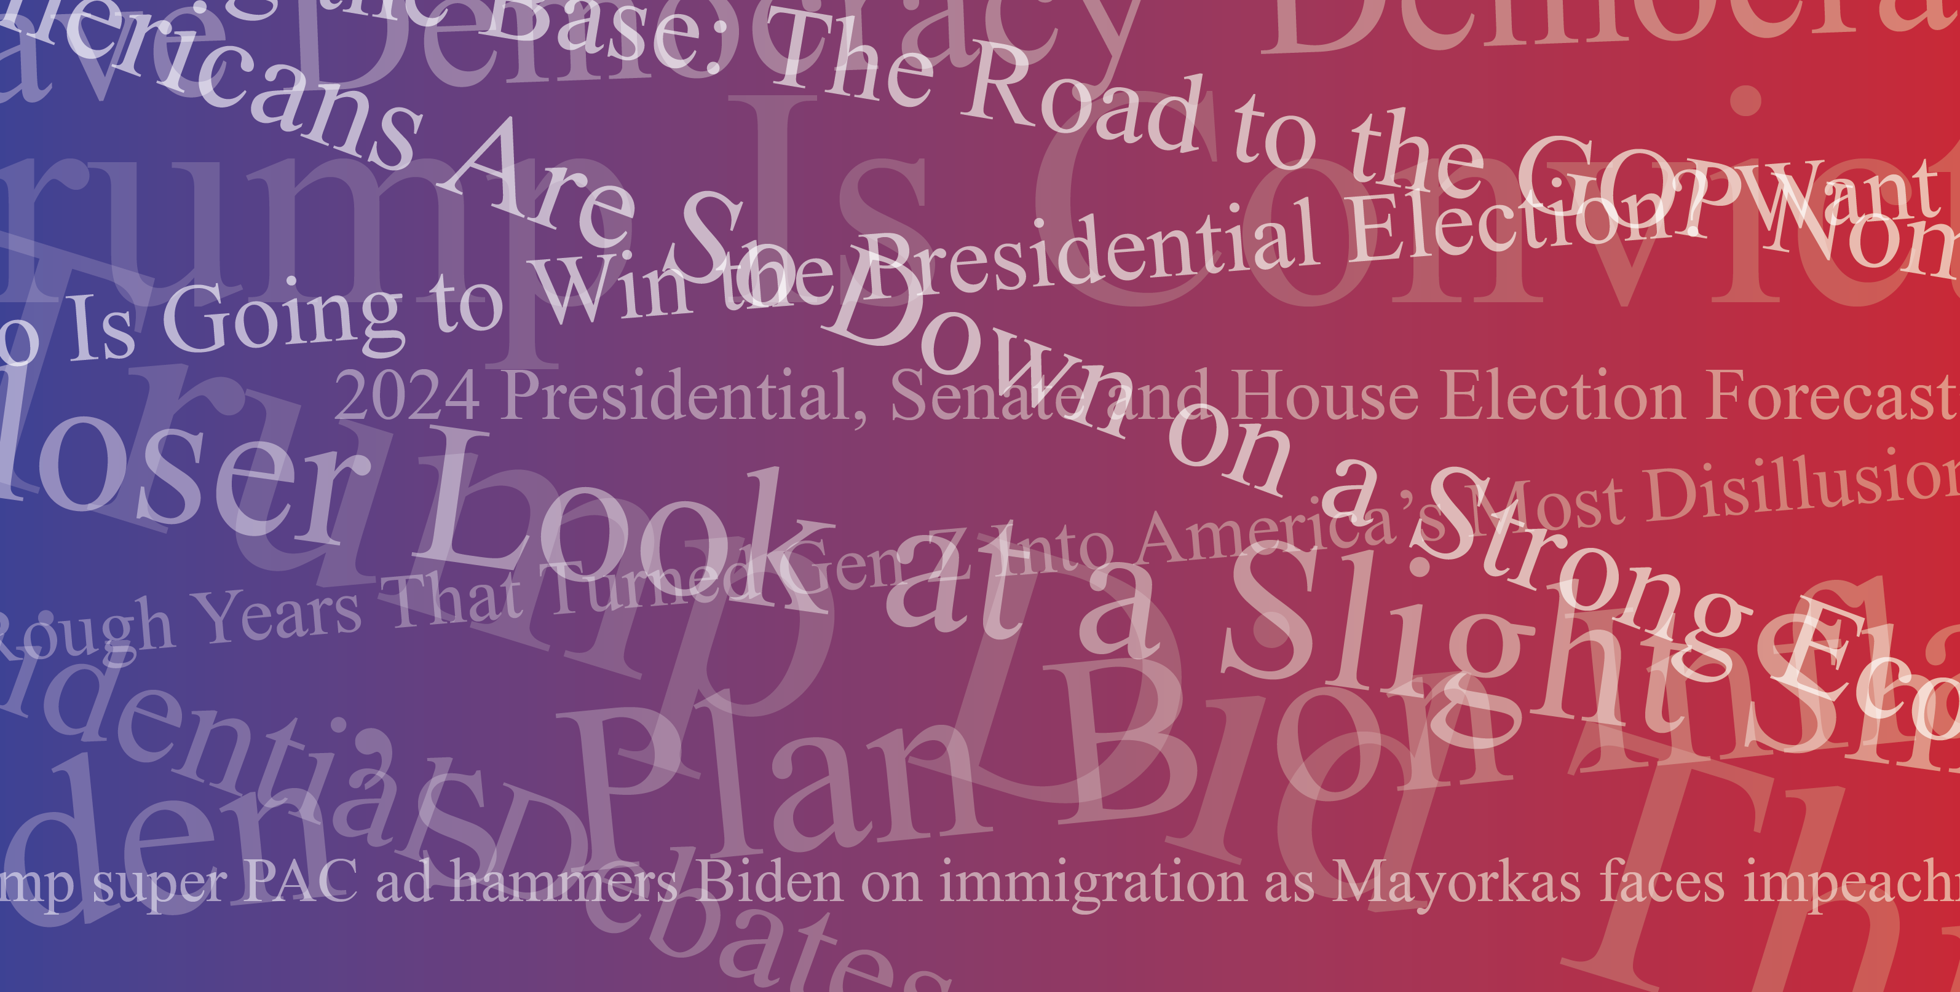
© 2024 by Hartford Funds
Notes:
Discuss the ubiquitous nature of election news.

Slide 3
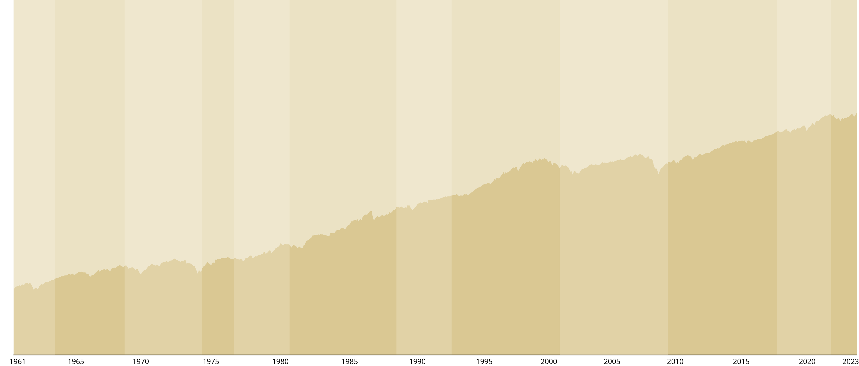
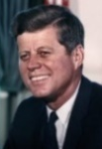
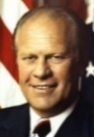
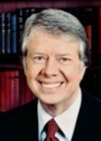
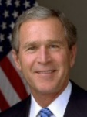
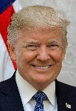
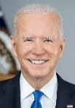


Don’t Let Politics Derail Your Portfolio
Copyright © 2024 by Hartford Funds
A hypothetical $10,000 investment in the S&P 500 Index in 1961 would have grown to more than $5 million as of December 31, 2023.
John
Kennedy
1961–1963
12.4%
Bay of
Pigs
Cuban
Missile
Crisis
JFK
Assass-
inated
Lyndon
Johnson
1963–1969
10.3%
Riots in Watts,
Los Angeles
Assassination of Martin Luther King, Jr.
Tet Offensive, Vietnam
Richard
Nixon
1969–1974
-1.6%
Kent State Shootings
Watergate Scandal
Oil Embargo
Gerald
Ford
1974–1977
18.1%
US
Withdraws from
Vietnam
“Whip
Inflation
Now”
Jimmy
Carter
1977–1981
11.7%
Hostage
Crisis in Iran
Oil Crisis
Record-High Inflation
Ronald
Reagan
1981–1989
14.2%
Record Unemployment
Iran Contra Scandal
US Bombs Libya
George
H.W. Bush
1989–1993
15.7%
Iraq Invades Kuwait
Persian Gulf War (Desert Storm)
Los Angeles Riots
Bill
Clinton
1993–2001
17.2%
Dot-com Bubble
Clinton Impeached
Y2K Technology Fears
George
W. Bush
2001–2009
-2.9%
9/11
Iraq War
Global Financial
Crisis Begins
Barack
Obama
2009-2017
14.5%
General Motors Files for Bankruptcy
Unemployment Reaches 10%
First Brexit Referendum
Donald Trump
2017–2021
16.1%
COVID-19 Pandemic
Immigration
Crisis
Trump
Impeached
Joe
Biden
2021-2023
10.2%
Russia-Ukraine war
Surging
Inflation
Afghanistan Withdrawal
$5,119,518
$10,000
As of 12/31/23. Past performance does not guarantee future results. Data Source: Morningstar, 1/24. Investors cannot directly invest in indices
Notes:
Read slide

Slide 4
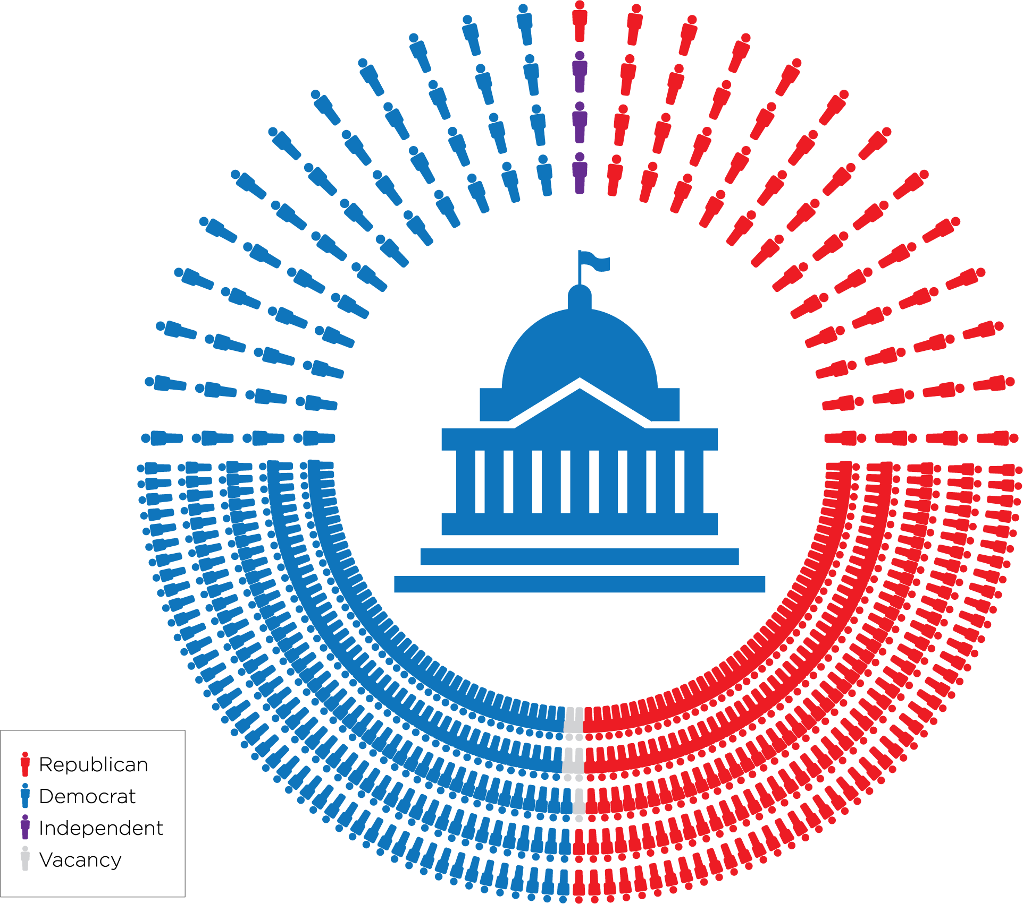
Makeup of Congress
Senate
Party | Members
Democratic | 48
Republican | 49
Independent | 3
Total | 100
House
Party | Members
Democratic | 213
Republican | 217
Vacancies | 5
Total | 435
Source: List of current members of the U.S. Congress, Ballotpedia, 4/24.
Notes:
Discuss slide.

Slide 5
House Flip?
2022 Republican-held US House districts won by
President Joe Biden in 2020:
 | BIDEN MARGIN
Arizona's 1st | 1.50%
California's 22nd | 12.90%
California's 27th | 12.40%
California's 40th | 1.90%
California's 45th | 6.20%
Illinois' 13th | 11.20%
Michigan's 3rd | 8.50%
 | BIDEN MARGIN
North Carolina's 13th | 1.70%
Nebraska's 2nd | 6.30%
New Mexico's 2nd | 5.90%
New York's 1st | 0.20%
New York's 22nd | 7.50%
Ohio's 1st | 8.50%
Pennsylvania's 1st | 4.60%
All 435 House seats are up for election
Republicans currently hold a slim majority
Source: US House districts represented by a Republican in 2022 and won by Joe Biden in 2020, Ballotpedia, 4/24.
Notes:
All 435 House seats are up for election. Interestingly, only about 40 of those are even competitive and only less than 25 are truly toss-up races. Think about that—only 25 seats out of 435 in the House of Representatives are truly toss-ups.
Currently, the House is controlled by a very slim Republican majority. The problem for the Republicans is that in 2022, they picked up 14 seats in districts that President Joe Biden won in 2020.
As a result, according to JT Taylor, with Senior Policy Analyst with Hedgeye Potomac Research, it's likely that in the November elections, all else given as it exists today, the House could flip from a Republican to a Democratic majority.

Slide 6
Senate Flip?
34 Senate seats up
for election
23 are Democrats
11 are Republicans
Democrats currently hold a slim majority*
Democrats will be defending three Senate seats in states won by former President Donald Trump during the 2020 presidential election:
 | TRUMP MARGIN
Montana | 16.4%
Ohio | 8.1%
West Virginia | 38.9%
* There are three independents who caucus with Democrats
Source: States won by Donald Trump in 2020 with Democratic-held US Senate seats up for election in 2024, Ballotpedia, 4/24.
Notes:
JT also thinks the Senate could flip from a Democratic majority to a Republican majority because Democrats will be defending three Senate seats in states won by former President Donald Trump during the 2020 presidential election.

Slide 7
Market Returns Have Been Better With Divided Government
Average Annual S&P 500 Index Returns (1937–2023)
Divided Government
(President and Congress represented different political parties)
Unified Government
(President and Congress represented the same political party)
Past performance does not guarantee future results.
Data Sources: Morningstar and Hartford Funds, 4/24; Party Divisions of the House of Representatives, 1789 to Present, History Art & Archives US House of Representatives, 2024; Party Division, US Senate, 2024
Investors cannot directly invest in indices
Notes:
Read slide

Slide 8
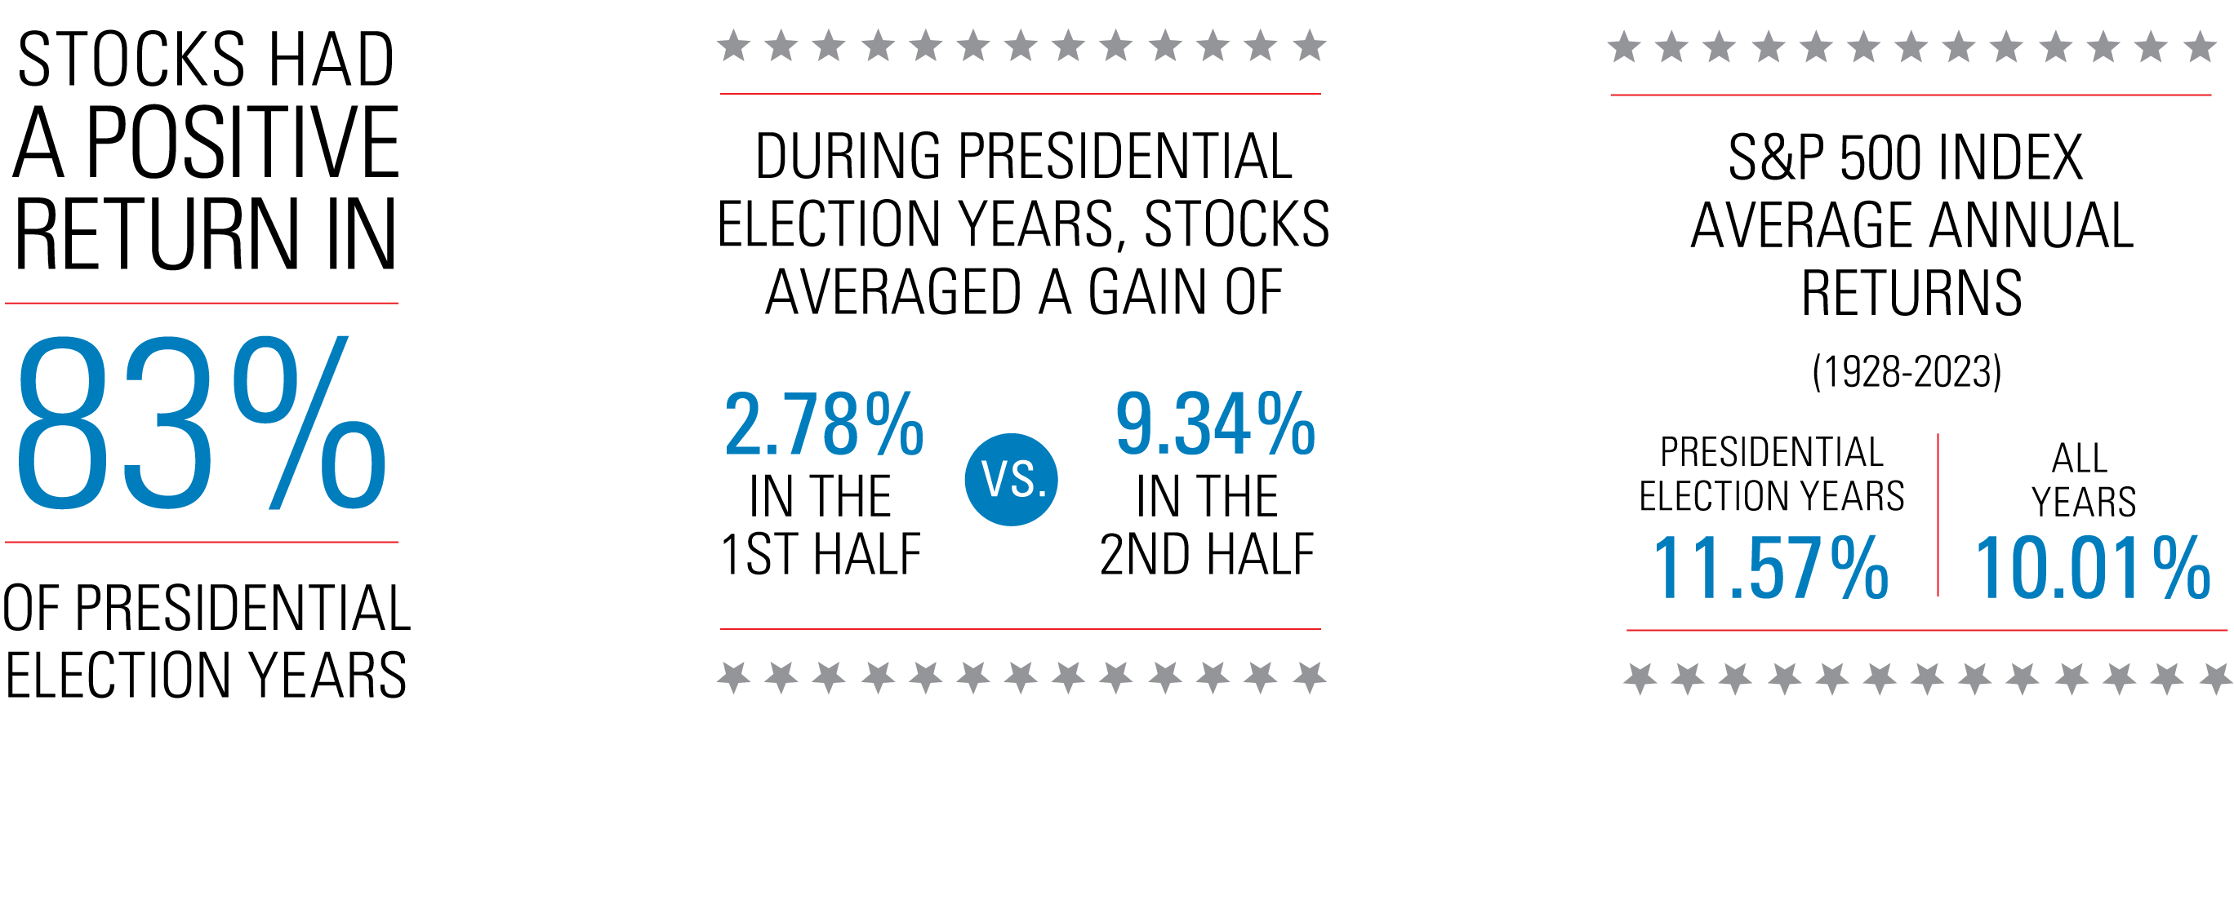
Presidential Election Years Have Been Good for Investors
Based on elections since 1928 and the returns for the S&P 500. Past performance does not guarantee future results. Investors cannot directly invest in indices. For illustrative purposes only. Data Source: Morningstar, 3/24.
Notes:
Discuss how market returns are more dependent on the outlook for the economy than on the outcome of an election.

Slide 9
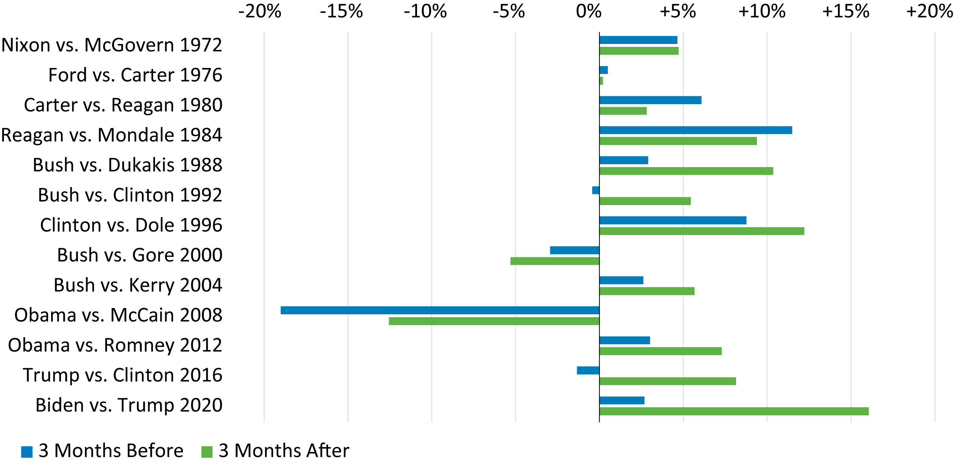
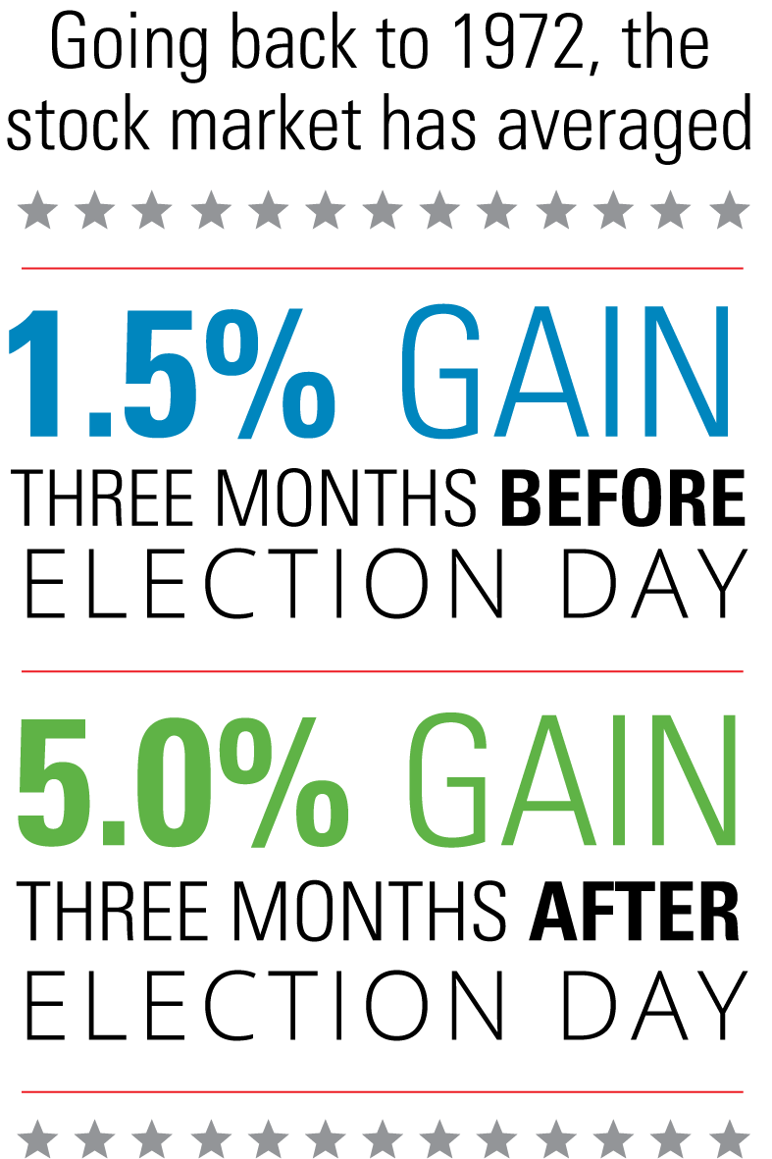
Thinking of Changing Your Portfolio Because of the Election?
Market Performance Tends to Be Positive 3 Months Before and After Presidential Elections
S&P 500 Index (% Returns)
Past performance does not guarantee future results. For illustrative purposes only. Investors cannot directly invest in indices. Data Source: Morningstar, 1/ 24.
Notes:
Discuss how presidential election years have been good for investors, and how elections can create uncertainty, but sitting on the sidelines could be a costly mistake.

Slide 10
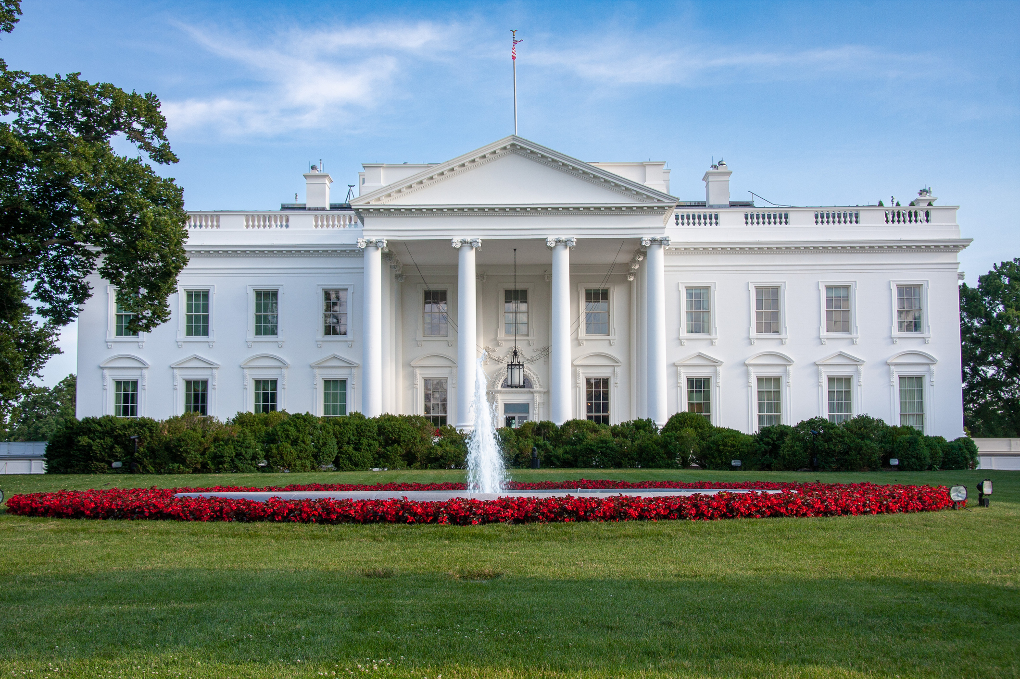

The White House and Your House
Presidential Priorities:
The Next 4 Years
Your Priorities:
The Next 40 Years
Notes:
Presidential Priorities: The Next 4 Years
We all expect presidential candidates to discuss certain issues. Their positions on these issues create the platform on which they run. Topics range from domestic to international concerns, and the candidates’ views often determine how people vote.
Your Priorities: The Next 40 Years
Presidential candidates have a four-year vision. We the people, on the other hand, need to plan for the next 40+ years. Planning your finances for retirement is crucial to ensure you can enjoy those golden years with financial security.

Slide 11

Next Steps
Get election insights at our Politics Resource Center: hartfordfunds.com/politics
Remember: A financial professional can help you build a portfolio that’s right for you regardless of what’s happening in Washington, D.C.
CCWP_059
S&P 500 Index is a market capitalization-weighted price index composed of 500 widely held common stocks. Indices are unmanaged and not available for direct investment.
Important Risks: Investing involves risk, including the possible loss of principal.
JT Taylor is affiliated with Hedgeye Potomac Research. Hedgeye Potomac Research is not an affiliate or subsidiary of Hartford Funds.
This information should not be considered investment advice or a recommendation to buy/sell any security. In addition, it does not take into account the specific investment objectives, tax, and financial condition of any specific person. This information has been prepared from sources believed reliable, but the accuracy and completeness of the information cannot be guaranteed. This material and/or its contents are current at the time of writing and are subject to change without notice.
Hartford Funds Distributors, LLC, Member FINRA. SEM_Politics_0524 3573258 / 3552334 V / 3552359 V

